Slide 1

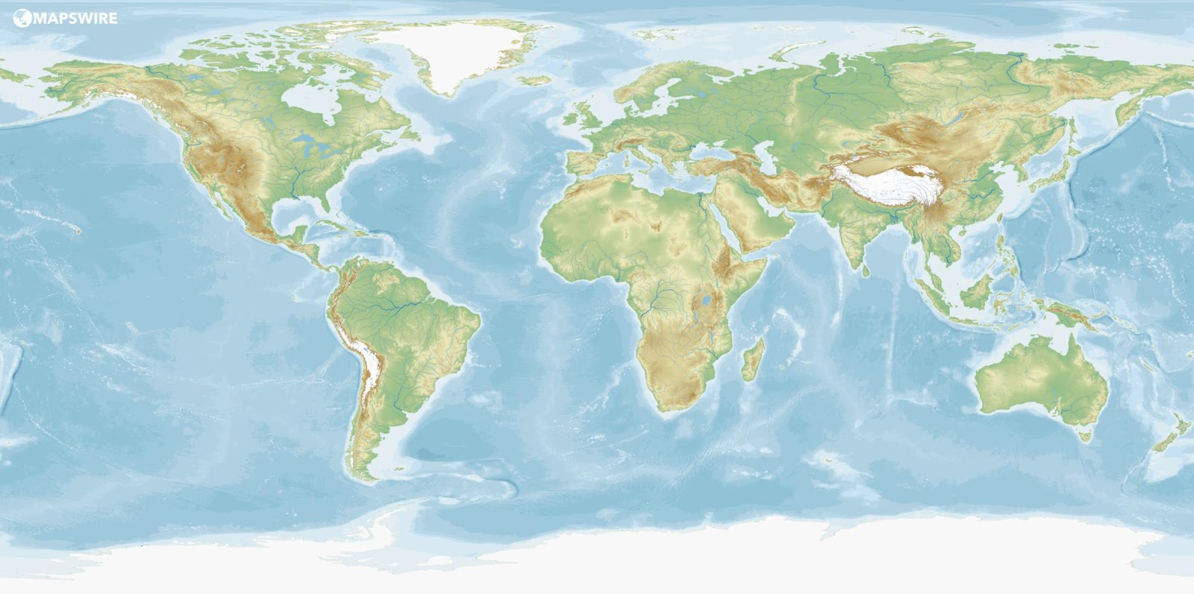
50 ways to bring international to your programme

Slide 2
These slides are aimed to provide ideas and inspiration on different ways of bringing international into your unit without ever necessarily leaving the UK.
We hope there are ideas suitable for all ages -Rainbows, Brownies, Guides, Rangers and Trefoil.
Some could be done in unit meetings, others at camps or holidays. Some may require computers and could be part of a virtual meeting or for girls to do at home with families.
We hope the ideas are useful and it helps to show how truly amazing Our Planet and it’s People are
LaSER International Team

Slide 3
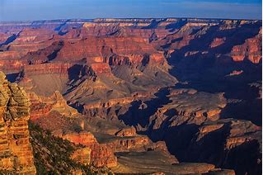
Virtual visits to landmarks
Is there somewhere you have always wanted to go ?
Or somewhere unit members have?
Visit it online – lots of places have virtual visits on their websites or you could use Google Earth to explore
Notes:
For inspiration https://www.techradar.com/uk/best/virtual-tours-museums-national-parks-around-the-world

Slide 4

Google Earth
Use Google Earth to explore the world and visit places the girls have heard of.
Do a Scavenger hunt or Treasure Hunt
Notes:
https://www.google.co.uk/intl/en_uk/earth/
https://www.foxworldtravel.com/wonders-of-the-world-google-earth-scavenger-hunt/

Slide 5
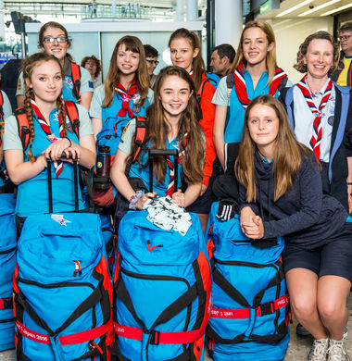
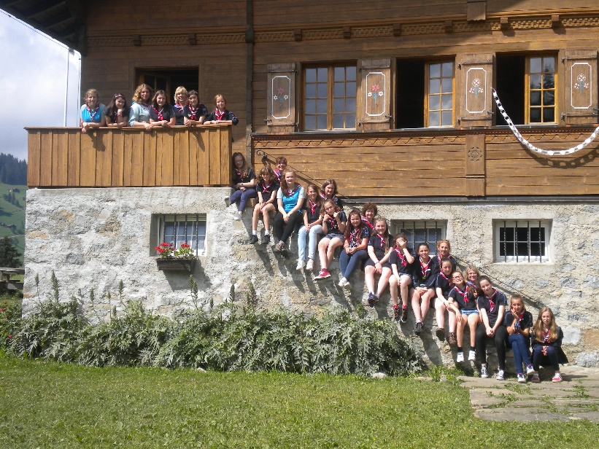
Guiding international trips storytelling
Ask someone who has been on an international trip with Girlguiding to come and talk to the unit about their experience, the fun, the challenges and the memories.
Notes:
LaSER Region website has case studies https://www.girlguidinglaser.org.uk/news?in=international
And lots of groups have created videos of their trips on youtube

Slide 6
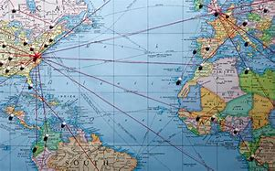
Planning an international trip
Spend an evening planning an imaginary international trip with your unit.
What do they need to think about?
Where to go, how to get there, who will go, what to take, what will they see and do?
The sky’s the limit for an imaginary trip!

Slide 7
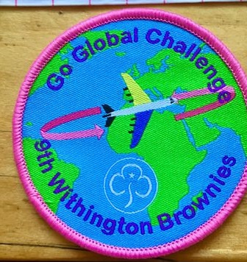
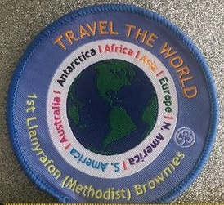

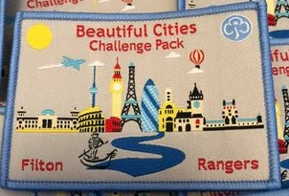
International Themed Challenge Badges
Lots of guiding areas and groups have made 'challenge badges' on an international theme.
Find one that appeals to you and your unit and use/adapt the activities to your current setting.
Notes:
Facebook group – search for and join Girlguiding Unofficial Challenge Badges (For Leaders)
Or Girlguiding Scotland has two good resources
https://www.girlguidingscotland.org.uk/for-volunteers/how-to-run-your-unit/challenge-badges/window-on-the-world/
https://www.girlguidingscotland.org.uk/for-volunteers/how-to-run-your-unit/challenge-badges/lets-go-global/

Slide 8

Sustainable Travel
Explore with the unit what is sustainable travel.
What can they do to protect the planet and local communities when exploring the world?
How can you offset your Carbon Emissions?

Slide 9
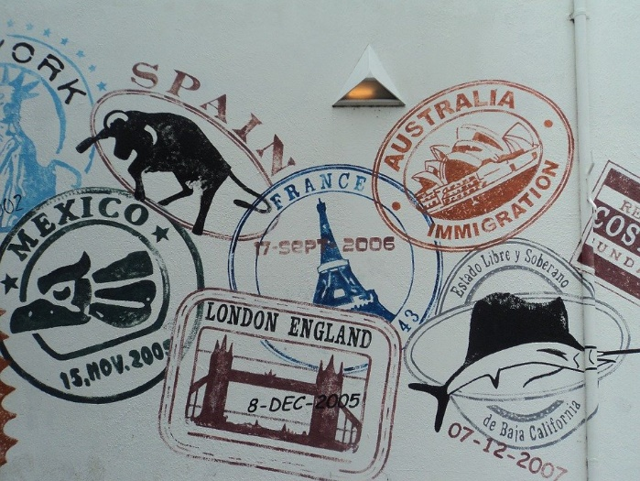
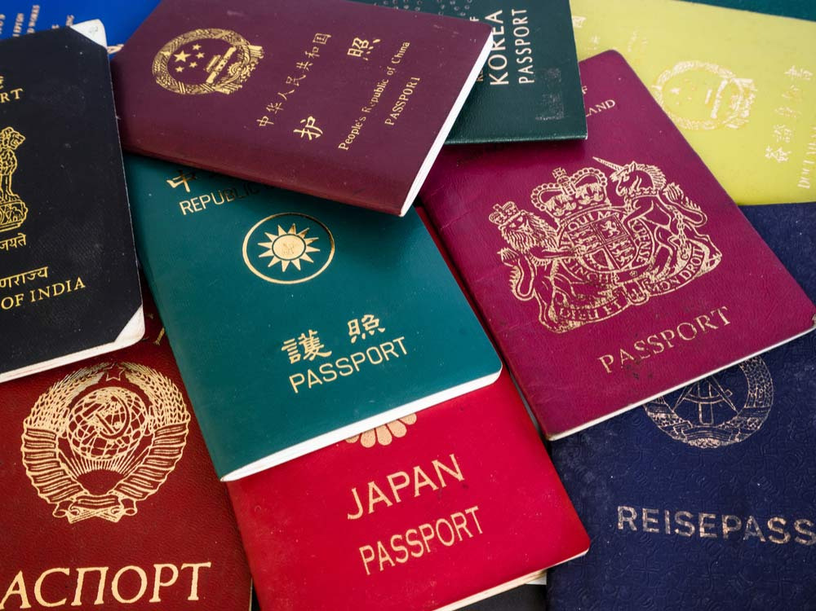
Passport Stamps
In years gone by every time you visited a country you got a stamp in your passport, but this doesn’t happen in all countries now.
Why not create a digital passport for your unit and use it to log all the countries you visit with your unit in a year.
Could your unit design a 'passport' stamp to represent where you live/your unit?

Slide 10
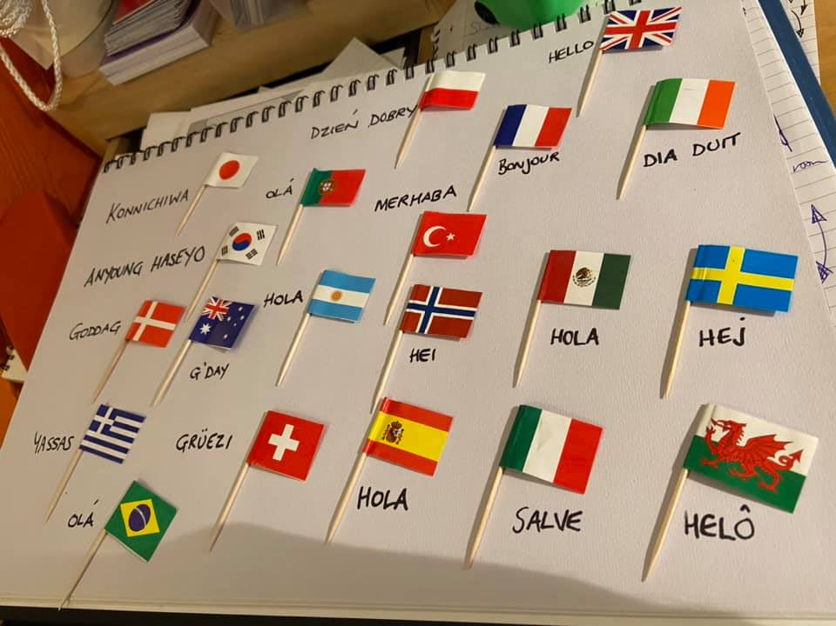
Languages
How many languages can your unit say hello or goodbye in?
Could you start every meeting for a term with a greeting in a different language?
Decorate your meeting place with the words or add to your unit’s digital passport.

Slide 11
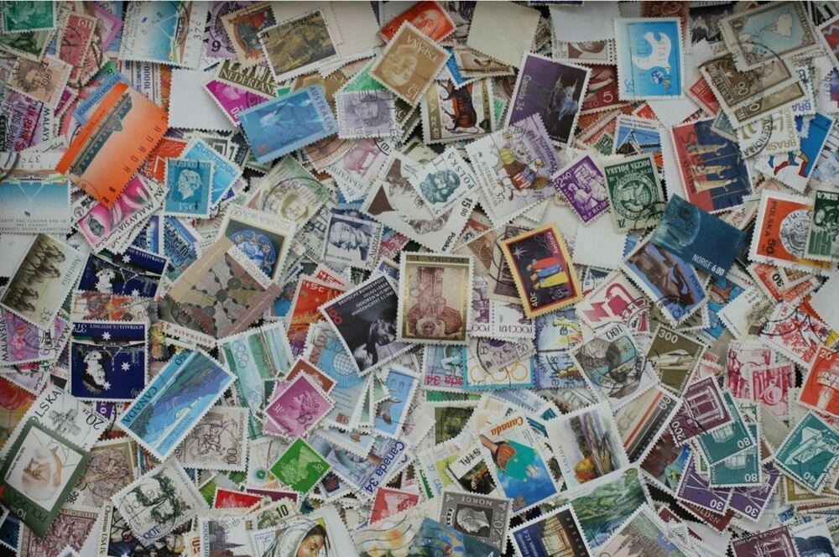
Stamp Collecting and the history of Stamps
The invention of stamps enabled people to keep in touch with people in other countries more easily.
Investigate who invented them and what different countries have on their stamps.
Design your own unit commemorative stamp.
Notes:
Postal Museum has lots of information about stamps and stamp collecting
https://www.postalmuseum.org/blog/beginners-guide-to-stamp-collecting/?gclid=Cj0KCQiA88X_BRDUARIsACVMYD97-P5hAI-gt3Sdu8hNFkq1eP0Oxrkce0QEeTV6Qqbzlbf2emc7FTwaAgJZEALw_wcB

Slide 12

Flags of the world
Explore with your unit flags from different countries :
How many can they guess in a quiz?
Ask each member to find, bring or make the flag of a country they would like to visit.
What is the most common colour in flags?
What is the newest flag in the world?
Show a flag and then visit that country on Google Earth.

Slide 13
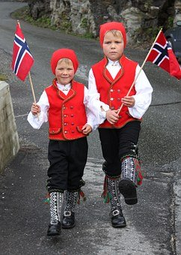
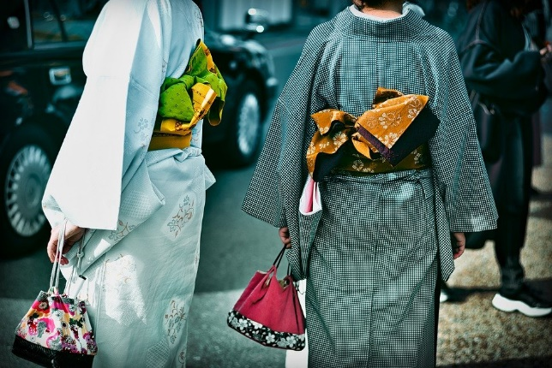
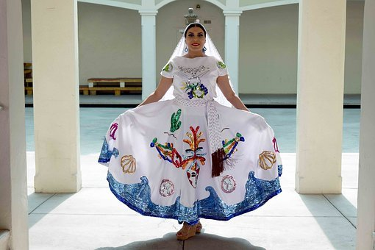
National Dress
Look at different national dress of other countries.
Try re-creating some using items the unit can find at home - being respectful and culturally sensitive.
Explore with them what the national dress means to the people of that country.

Slide 14
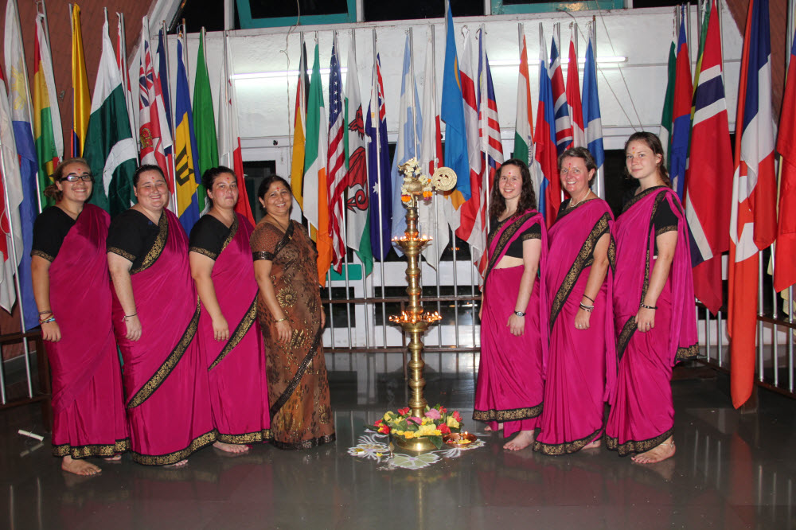
How to wear a Sari
Many women in the world wear a Sari – teach your unit members how to tie and wear a Sari.
There are videos online or you may have parents or local community members who can show you how.
Notes:
If you don’t have the materials and /or girls are at home could they use newspaper stuck together to make the 6m length as a demonstration aid

Slide 15
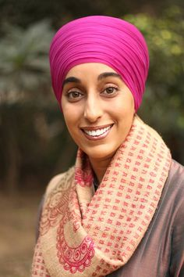
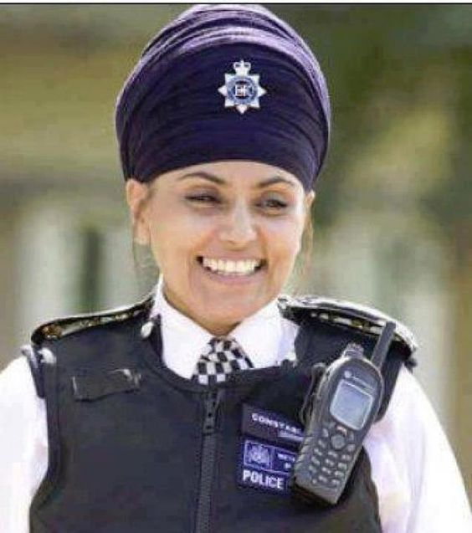
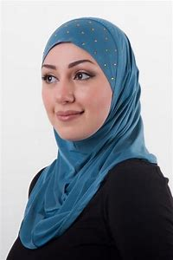
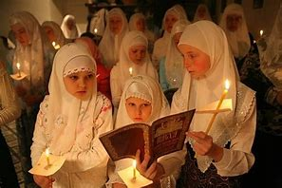
Covering the head
In many religions, cultures and countries women wear something to cover their head.
Explore with your group why and the meaning behind it?
For example:
Muslim women may wear the Hijab
Sikh women may wear a turban
Christian women may wear a head scarf
Jewish women may wear a Tichel

Slide 16
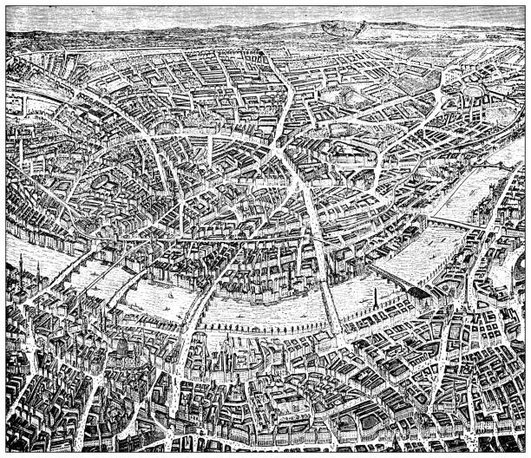
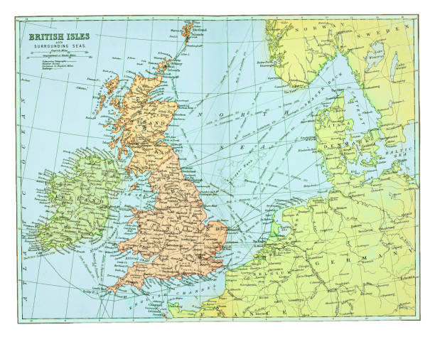
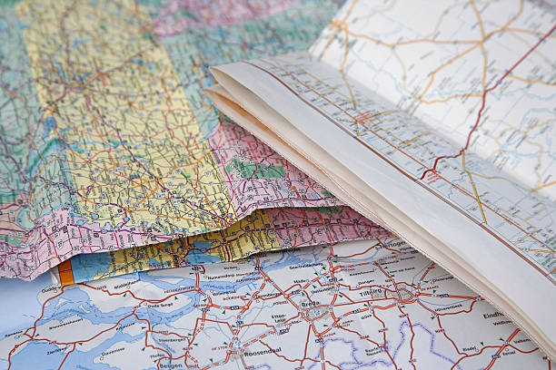
Maps
Cartography is the study and practice of making maps.
Explore how Maps were first drawn, show images of early maps, imagine what it would be like exploring a new place which had never been mapped.

Slide 17
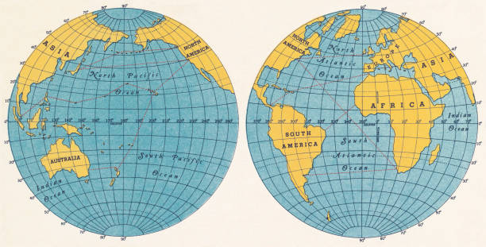
Latitude and Longitude
Explore what is latitude and longitude.
Who invented it?
Why is it useful for us when travelling?
A chocolate orange is a good demonstration tool for the leaders too!
Notes:
BBC Bitesize has a good explanation
https://www.bbc.co.uk/bitesize/topics/zvsfr82/articles/zd4rmfr

Slide 18
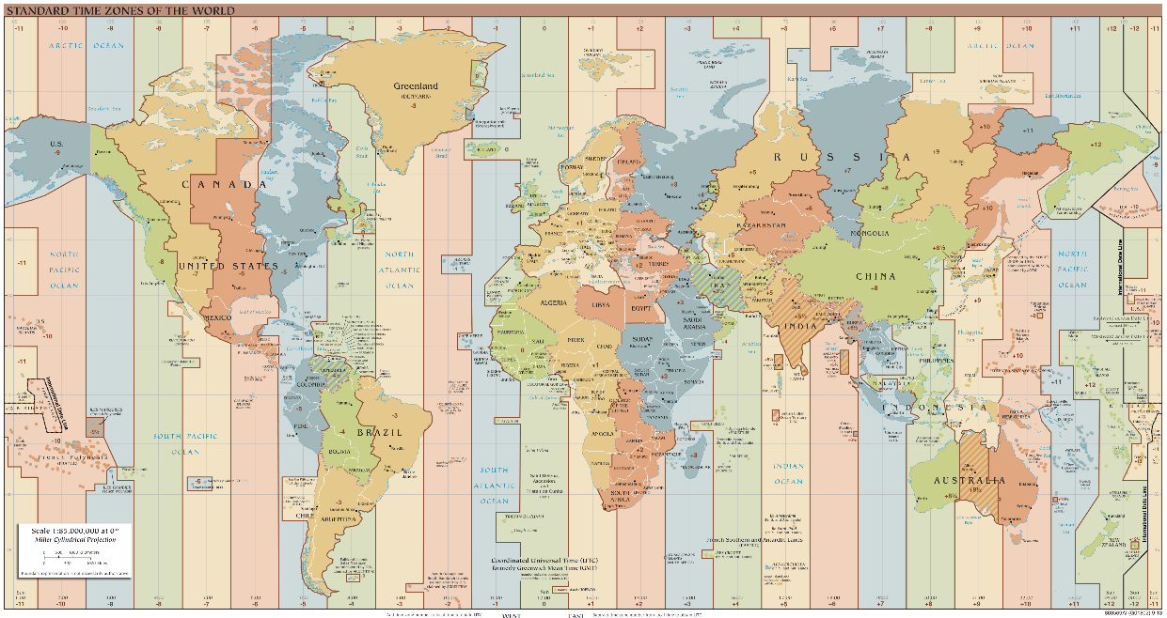

24 Hours New Year
There are 24 different time zones in the world which means New Year is celebrated at different times in the world.
Use a time zone map to explore who celebrates first.
Use a globe and torch to demonstrate how and why a standard time zone system works
Notes:
This website is a good tool to demonstrate : www.timeanddate.com/time/map
National Geographic has a tool for understanding time zones -https://www.nationalgeographic.org/media/understanding-time-zones/

Slide 19
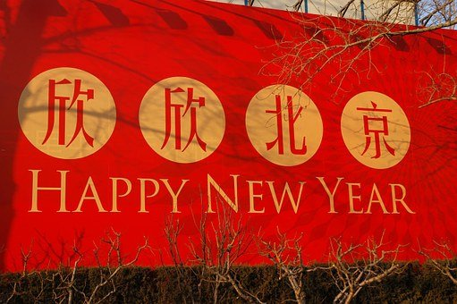
Chinese New Year
Celebrate Chinese New Year – which is based on the beginning of the year on the Lunar Calendar.
Try some Chinese food.
Find out about the giving and receiving of red envelopes for a safe and peaceful year.
Create Chinese crafts.
Learn some Chinese words.

Slide 20
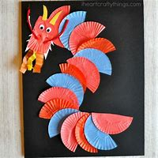
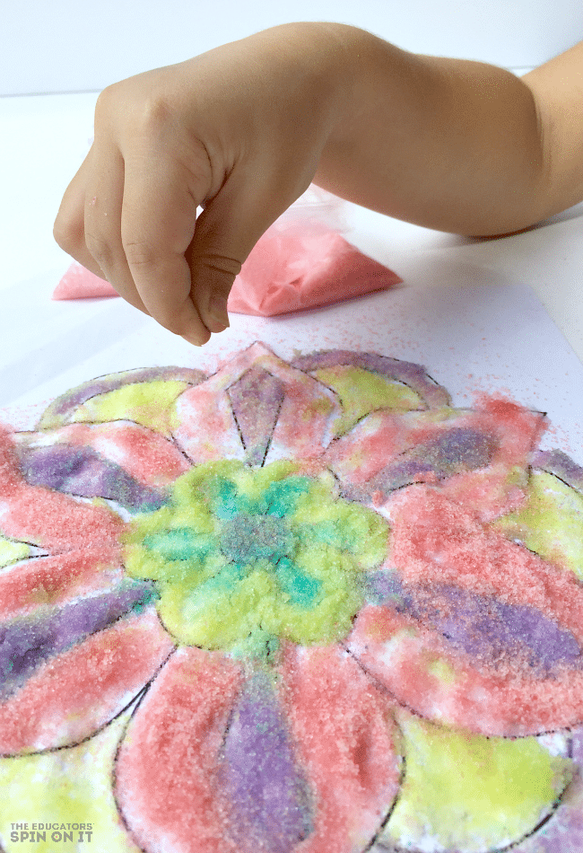

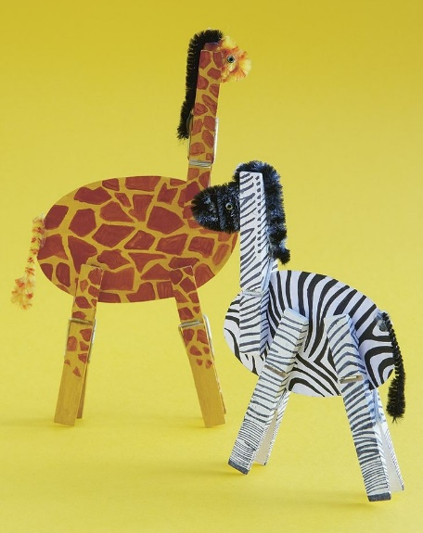
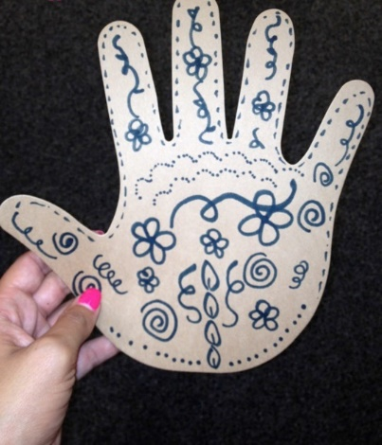
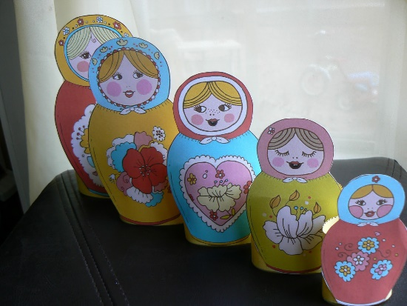
Crafts from around the World
Try international crafts with your unit and whilst doing it explore where they come from and why they are made.
Japanese fans, Mexican God’s eyes, Chinese Dragons, Indian Rangoli Art, Danish Hearts, Russian Dolls, African animals ……
The possibilities are endless and there are loads of ideas on the internet.

Slide 21

Animals of the World
There are so many beautiful and amazing animals in the world – find out more about them.
Ask all your unit to find out about an animal from another country and share.
Celebrate World Wildlife Day on 3 March or a particular animal’s days – 16 March Pandas, 10 August Lions, 23 May Turtles…
Visit a zoo or nature reserve (online or in person) and find out more about their conservation projects.
Notes:
Look for your favourite animal’s day here www.daysoftheyear.com

Slide 22
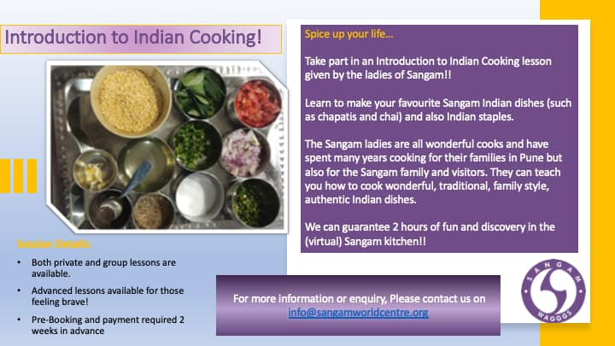
Cooking
Have a go at cooking simple dishes from other countries.
Explore where the ingredients come from in the world. What do your unit members know about those countries?
There may be parents who can help with ideas or teaching, or you could sign up to an online cooking session such as those run by Sangam
Notes:
You can book a cook along session with the staff at Sangam - contact them on info@sangamworldcentre.org (or check their facebook page).

Slide 23

Food investigating
Investigate where food comes from.
Collect food items from your cupboard/fridge or get the unit member to if they are at home.
Look on the labels to see where they have come from and map them out on a world map or online.
Does it surprise the unit ?
Perhaps discuss the carbon footprint of all food and how wise choices can reduce this.
Notes:
Useful articles
https://www.visualcapitalist.com/visualising-the-greenhouse-gas-impact-of-each-food/
https://www.bbc.co.uk/food/articles/carbon
https://www.oxfam.org.uk/education/home-learning-activities/food/

Slide 24


Chocolate
Chocolate is made from cocoa beans.
Where do they come from?
And how have fairtrade practices helped to make sure it is a fair world for the growers?
Run a trading game based on chocolate production.
Notes:
https://www.fairtrade.org.uk/get-involved/current-campaigns/fairtrade-fortnight/quiz-how-much-do-you-really-know-about-chocolate/
https://schools.fairtrade.org.uk/teaching-resources/activities-and-games/
https://www.oxfam.org.uk/education/home-learning-activities/food/

Slide 25

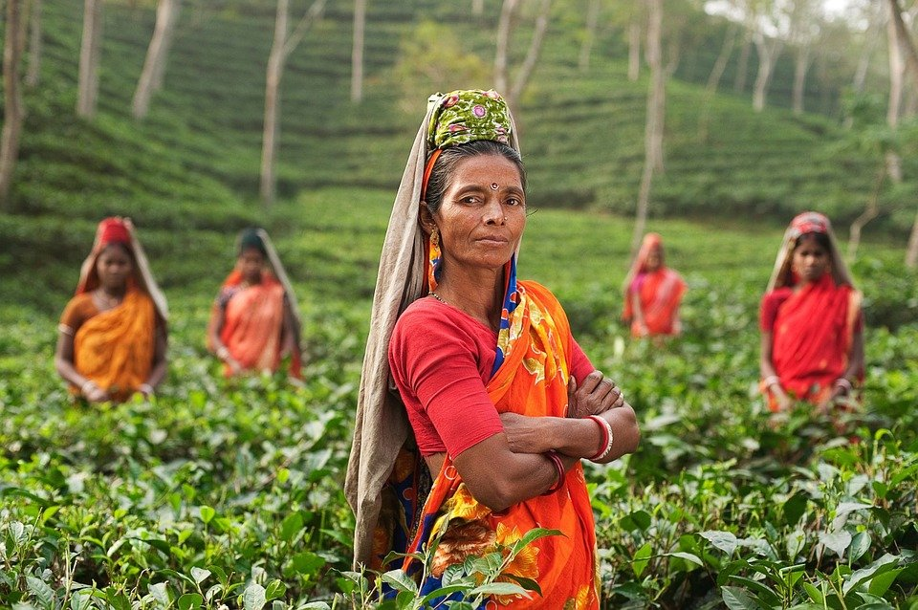
Tea
In the UK we drink lots of tea.
But we don’t generally grow it- so in which countries do they grow lots of the tea we drink?
Where are they in the world?
How does the tea get to us?
Investigate this with your unit and then share a proper cup of tea and chat together.

Slide 26

WAGGGS regions and members
What is WAGGGS?
What are the WAGGGS regions?
Explore which countries are members.
Get the unit to choose some countries and find out what their promise and laws are for each member organisation on the WAGGGS website.
How similar are they to ours?
Notes:
Full information about all member organisations, their logo, promise, membership is available on the WAGGGS website
https://www.wagggs.org/en/our-world/

Slide 27
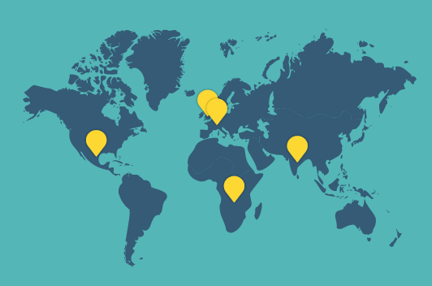
WAGGGS World Centres
Where are the WAGGGS world centres?
Why do they exist?
Visit them virtually either by watching one of their videos or book a hosted session.
Or invite someone to talk who has been there.
OUR CABAÑA, MEXICO
PAX LODGE, UK
OUR CHALET, SWITZERLAND
KUSAFIRI, AFRICA
SANGAM, INDIA
Notes:
Some links
https://www.wagggs.org/en/our-world/world-centres/
https://www.youtube.com/user/SangamWorldCentre/videos
https://www.youtube.com/c/OurCabana/videos,

Slide 28




WAGGGS Resources
Explore the resources, badges and events available from WAGGGS through their website.
Each year new resources, based on current priorities and themes, are shared and used by all the member countries.
Notes:
https://www.wagggs.org/en/resources/resource-listing/

Slide 29
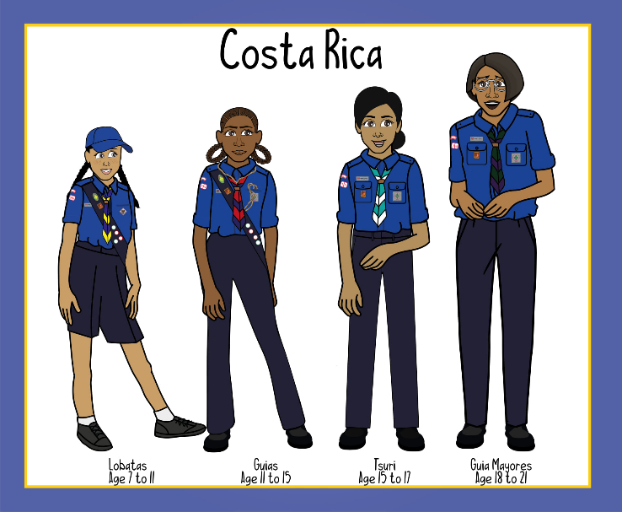

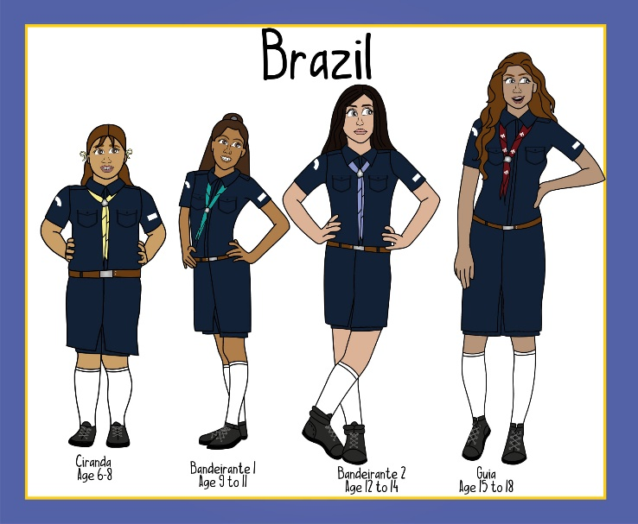
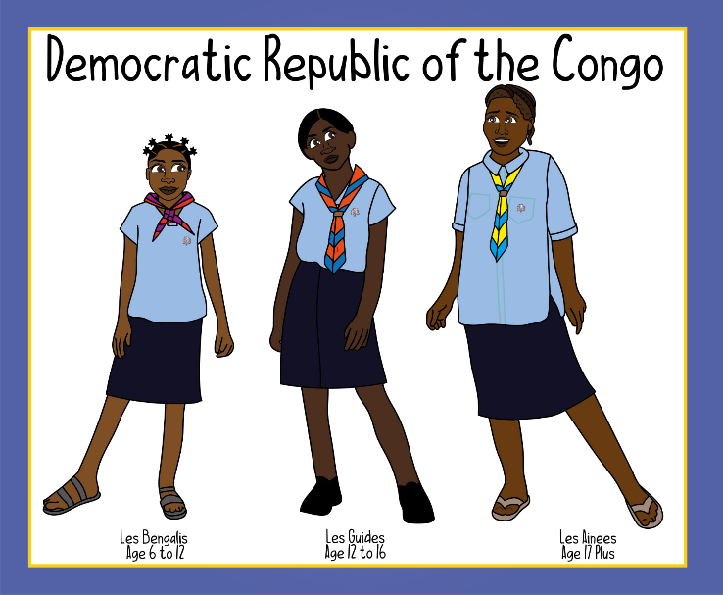
Uniforms
Find pictures of guiding uniforms in different countries and share with your unit.
What do they like about different uniforms?
How are some uniforms made to suit the climate of the country?
What are the similarities between uniforms?
Notes:
You can look on the WAGGGS website for information about member countries/organisations and then on their own website for information about their uniform
If you use facebook you can join the group called 'Lisa's illustrations'- as she has prepared pictures of uniforms from different countries across the world (as well as lots of other great images for guiding )

Slide 30

Twin with a unit from another country
Twin with a unit in another country
Share stories and photos
Have an online meet up
Plan challenges for each other
Ask questions
Leaders can often find units to twin with through personal contacts, facebook groups or international Jamborees and events
Notes:
Lots of leaders have met leaders from other groups at events like Jamborees, or can make contact through friends or social media groups on facebook or similar
Reach out and make contact with another group –ensuring a safe way of communicating between the units (so no direct young people email exchanges )

Slide 31



United Nations and Unicef
Who are the United Nations and Unicef?
Voices of Youth is UNICEF’s online place for young people to learn more about issues affecting their world and share their thoughts and opinions with thousands of people from all over the world.
Share with your unit (and their parents) as a place young people can engage with others on these topics.
Notes:
https://www.un.org/en/sections/resources-different-audiences/students/index.html
https://www.voicesofyouth.org/

Slide 32



Explore Sustainable Development Goals
The SDGs are a collection of 17 interlinked global goals designed to be a “blueprint to achieve a better and more sustainable future for all”.
Explore one or more of these with your unit.
The European Jamboree (now cancelled) produced a resource called ‘Connecting Experience' full of ideas you can use on their website.
Girlguiding Scotland also has a resource on SDGs on their website.
Notes:
https://www.un.org/sustainabledevelopment/sustainable-development-goals/
https://www.girlguidingscotland.org.uk/for-volunteers/how-to-run-your-unit/challenge-badges/sustainable-development-goals-challenge/
The now cancelled European Jamboree produced a great resource all around the SDGs still available on their website - full of sessions and ideas against each of the SDGs
https://ej2020.org/wp-content/uploads/sdg/EJ2020_Connecting-Experience-All-EN.pdf
https://ej2020.org/connecting-experience/

Slide 33

The World's Largest Lesson
The World's Largest Lesson is an event/website full of ideas and resources around the Sustainable Development Goals.
Ideas for all ages, games, posters, videos to help you explore the SDGs with your unit.
Notes:
https://worldslargestlesson.globalgoals.org/

Slide 34






Aid Agencies
An aid agency, also known as development charity, is an organisation dedicated to distributing aid – both humanitarian aid (emergency relief efforts, e.g. in response to natural disasters), and development aid, aimed at helping countries to achieve long-term sustainable economic growth, with the aim of achieving poverty reduction.
Explore with the girls what are Aid Agencies, what do they do, how do they help.
Notes:
https://www.girlguiding.org.uk/what-we-do/our-badges-and-activities/activity-finder/aid-agency/

Slide 35

Paintings
Create an art gallery of your unit's work (virtually or on the walls in your meeting place).
Visit an Art Gallery, in person or virtually, and explore which countries the paintings or artists are from:
Louvre in Paris
J. Paul Getty in Los Angeles
Vatican in Rome
Rijksmuseum in Amsterdam
Notes:
https://www.theguardian.com/travel/2020/mar/23/10-of-the-worlds-best-virtual-museum-and-art-gallery-tours

Slide 36

Quizzes
Hold an international themed quiz with your unit.
Perhaps get every young person to come up with their own international question and together you have a quiz rather than the leaders having to write it!

Slide 37

Blue Peter Green Badge
As a unit work towards the Blue Peter Green badge.
Explore environmental ideas about how each individual can help to protect the planet when travelling.
Write a poem, a story, create some artwork or take photos and get the girls to apply to Blue Peter for their Green Badge if they want.
Notes:
https://www.bbc.co.uk/cbbc/joinin/about-blue-peter-badges

Slide 38


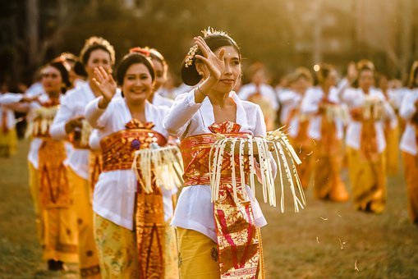

Celebrate festivals
Festivals are a big part of many people’s lives.
Some celebrate religious beliefs, others commemorate national occasions whilst some are linked to the love of an activity.
Pick some to celebrate each year and find out more about them.

Slide 39
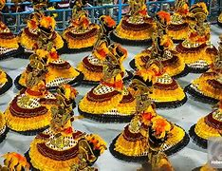
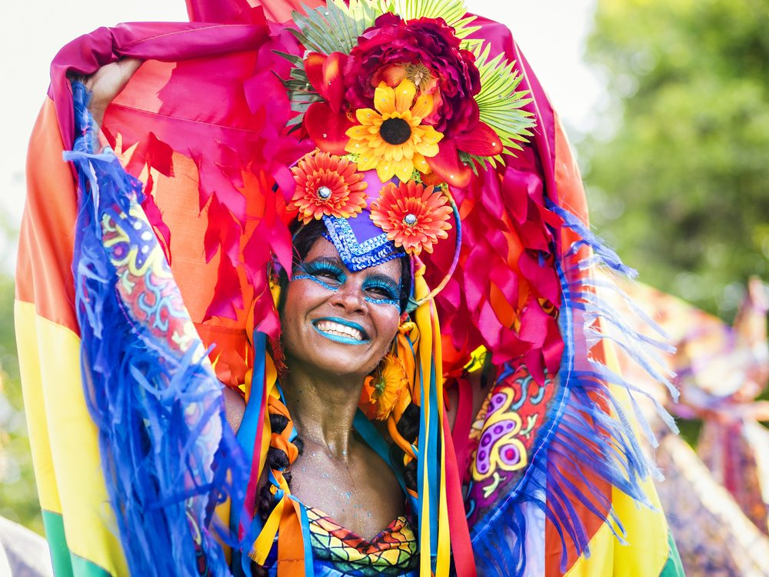
Carnival
Host a carnival with costumes, music and food to celebrate Carnival.
The Rio Carnival happens in February each year but lots of countries have different carnivals and festivals you can celebrate.
Notes:
https://www.girlguiding.org.uk/what-we-do/our-badges-and-activities/activity-finder/carnival-time/

Slide 40

Hot Air Balloons
Hot Air Balloons were the first way air mail was transported, inspired stories, races and festivals around the world.
Watch some videos from Hot Air Balloon festivals then design your own hot air balloons.
Notes:
Bristol - http://bristolballoonfiesta.co.uk/
Albuquerque , USA - https://balloonfiesta.com/
Mexico - https://www.bbc.co.uk/news/av/world-latin-america-24977057

Slide 41
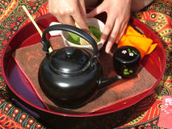
Japanese Tea Ceremony
An old tradition in Japan is the Tea Ceremony.
You could hold your own in a face to face or online meeting explaining the significance of all the actions.
Notes:
UK contingent to the World Scout Jamboree in Japan in 2015 has an online resource pack which includes lots of Japanese ideas including a Tea Ceremony
https://members.scouts.org.uk/documents/International/JapaninaBoxPack.pdf

Slide 42
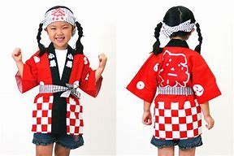
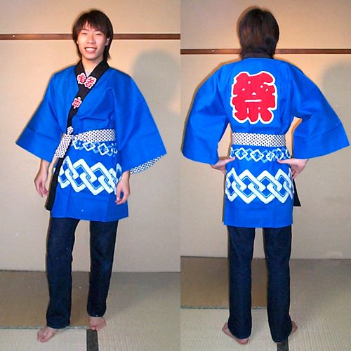
Design a Japanese Happi Coat
Happi Coats are a traditional coat that is worn in Japan at time of celebration, or festivals (similar to how in the UK we might get T-shirts made).
Get the girls to design their own.
Notes:
Page 25 of this resource from the UK contingent to the World Scout Jamboree in Japan has a pattern and more information https://members.scouts.org.uk/documents/International/JapaninaBoxPack.pdf

Slide 43
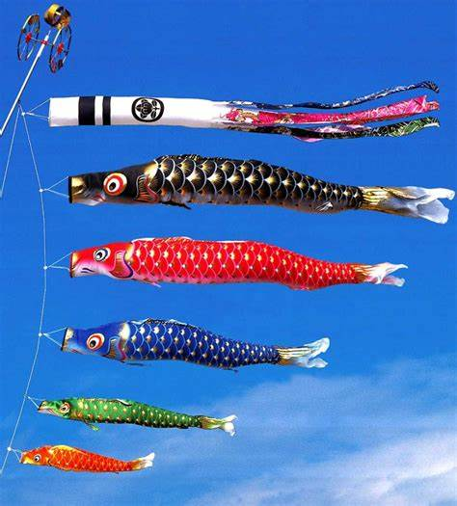
Japanese Children’s Day
In Japan on the 5th day of the 5th month it is Children’s Day - a day to celebrate children's personalities and celebrate happy children.
Find out what they do to celebrate.
Notes:
Page 6 of this resource from the UK contingent World Scout Jamboree in Japan https://members.scouts.org.uk/documents/International/JapaninaBoxPack.pdf

Slide 44

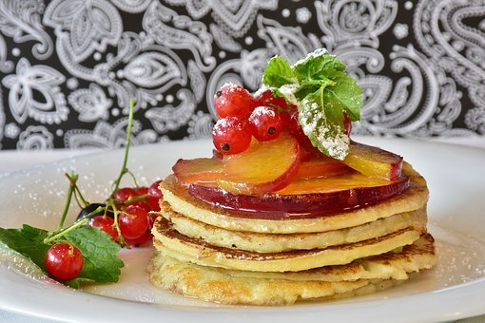
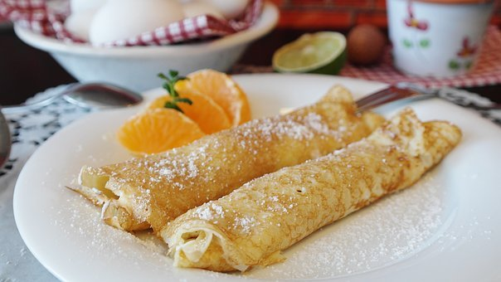
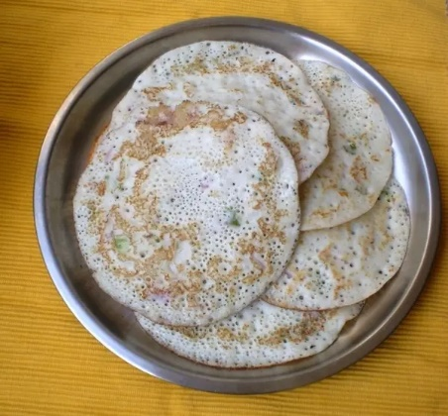
Pancakes
Pancakes are made /eaten differently across the world. Explore many of the ways and do a taste test...
Lemon and Sugar in the UK
Maple Syrup in Canada
Crepes in France
Pannukakku in Finland
Savoury pancakes
Tiganites in Greece
Uttapam in India
Raggmunk in Sweden
Notes:
https://www.buzzfeed.com/tashweenali/pancakes-from-around-the-world

Slide 45







Symbols and Packaging
Much of our food comes from around the world but what organisations exist to protect the planet and the communities?
What do the symbols on the packaging mean - what should we be looking for when shopping?
Explore these with the unit.
Notes:
Packaging logos resource – see LaSER website

Slide 46

International Women’s Day
International Women's Day is a global day celebrating the social, economic, cultural and political achievements of women. The day also marks a call to action for accelerating gender parity.
Marked annually on 8th March.
The 2021 theme is
'Choose To Challenge'.
Notes:
https://www.girlguiding.org.uk/what-we-do/our-stories-and-news/blogs/six-superwomen-international-womens-day/
https://www.internationalwomensday.com/About

Slide 47

Fairtrade Fortnight
Each year Fairtrade Fortnight (in Feb/March) is a chance to share the stories of people who grow our food, drinks and cotton. And to consider how climate change is impacting them and what we can each do to ensure a fairer world to live in.
The Fairtrade Foundation has ideas and resources you can use.
Notes:
https://www.fairtrade.org.uk/Get-Involved/Current-campaigns/Fairtrade-Fortnight/

Slide 48

Race around the world
Get your unit in small teams to plan a route around the world in 8 stops!
Where would they go?
Where would they stop?
How would they get there?
Notes:
Encourage the unit in small groups to plan their ideal Around the World Journey

Slide 49


Girls in Action
The Girls in Action activity packs were created by Girlguiding in partnership with other charities
AVA
Plan UK
Childreach International
Railway Children
British Red Cross
Notes:
https://www.girlguiding.org.uk/what-we-do/our-badges-and-activities/activity-finder/girls-in-action/
The badges may not be available everywhere any more but the ideas are still useful

Slide 50


Future Girl
Take part in Girlguiding’s Future Girl activities as they are announced.
Or create your own internationally connected ones to complement the themes
Planet Protectors
Adventurers
Self Believers
Respect Makers
Barrier Breakers
Notes:
Girlguiding’s Future Girl Project
https://www.girlguiding.org.uk/girls-making-change/future-girl/

Slide 51
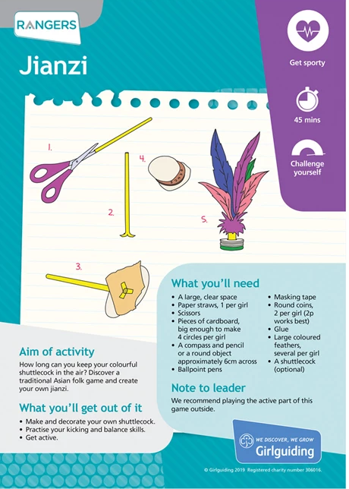
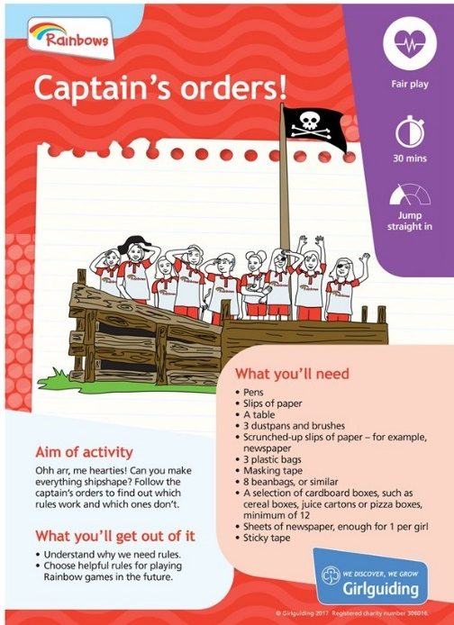
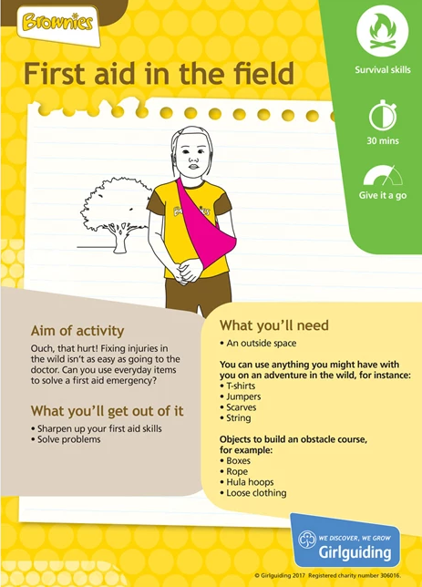

Interest badges, UMA’s and Skills Builders
Use existing UMAs and Skills Builders with an international element in your programme.
Or extend them to consider international elements e.g. where does that food come from, where in the world does that animal live, where does that craft come from?
Notes:
Girlguiding have shared on their website information on how to adapt all UMAs and Skills builders for online.
Those spreadsheets are useful for looking for ideas you can bring together
https://www.girlguiding.org.uk/making-guiding-happen/coronavirus-keeping-safe/starting-to-meet-in-person-again/adapting-programme-activities/

Slide 52

World Thinking Day
Do something each year on or around World Thinking Day with an international theme.
Use the WAGGGS resources or Girlguiding’s theme and badge for inspiration, explaining how many other Guides around the world will be doing the same.
But don't just wait for this one day – bring international into your programme every chance you get.
Notes:
https://www.wagggs.org/en/resources/world-thinking-day-2021-activity-pack/
https://www.girlguiding.org.uk/what-we-do/events-and-opportunities/regular-girlguiding-events/world-thinking-day/what-is-world-thinking-day/

Slide 53

50 ways to bring international to your programme
This Photo by Unknown Author is licensed under CC BY-NC-ND

