Slide 1
Brownie UMA ideas
The resources you need – pen and paper!

Slide 2
Trefoil trivia

Slide 3
Trefoil trivia
Whats the name of the Guiding symbol?
How many leaves are there?
As well as the leaves what else can you see?
What do the 3 leaves stand for?
Why is it yellow?
What do the stars represent?
Whats the compass needle for?
Which part is for the love of humans everywhere?

Slide 4
Lend a hand pillowcase
Your challenge
Show me something
You have 3 minutes to collect 10 things
Put them in a pillowcase
The things need to be random things you can find around the house.
Seek permission – nothing breakable
That you could use as a good turn
How many of your objects can you use to help others?
Try and do all the good turns you have identified this week.

Slide 5
Brownie pocket challenges
In your pocket you have….
Which item could you use…
White handkerchief
Plasters
Safety pin
10p piece
Piece of string
Note pad
Pencil
Dropped their car keys down a drain
Put your hand in wet paint
Neighbours dog is in the road and your neighbour is not home
To contact your sister who has left home to go to an appointment that he been cancelled
To help a friend who has cut their knee
Broken school bag on the way to school
And finally
What would you carry in your bag today to lend a hand?

Slide 6
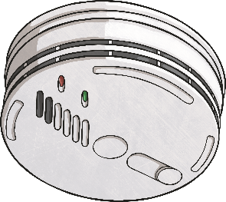
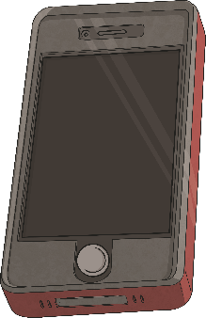
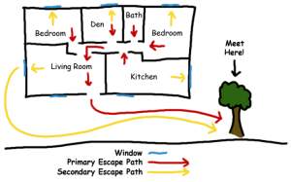
Fire, fire UMA Be Prepared –Be well
It isn’t nice to think about the possibility of a house fire. However, there are lots of things we can do to be prepared to stay safe.
Ask the adults you live with if your house has smoke alarms. Fire brigades advise a minimum of one per floor. Smoke alarms have test buttons to check they are working properly; they should be checked once a month.
Know how to make an emergency 999 call. After dialling 999, the operator will ask you which service you require. Ask for the fire brigade. Try to give as much information as you can, including the address. If you don’t know your home postcode, learn it.
Ask your family to have an escape plan ready in case there is a fire.

Slide 7
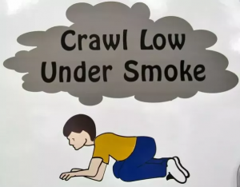
If there is smoke what should you do
Why on the ground?
Smoke and heat rise so staying low to the ground will help you to see better and breathe more easily.

Slide 8
How do you know if the fire is behind the door?
Look first
If you see smoke coming under the door — don't open the door!
If you don't see smoke — touch the door. If the door is hot or very warm — don't open the door!
If you don't see smoke — and the door is not hot — then use your fingers to lightly touch the doorknob. If the doorknob is hot or very warm — don't open the door!
If the doorknob feels cool, and you can't see any smoke around the door, open the door very carefully and slowly. When you open the door, if you feel a burst of heat or smoke pours into the room, quickly shut the door and make sure it is really closed. If there's no smoke or heat when you open the door, go toward your escape route exit.

Slide 9
If you can’t go through the door
YELL for help….
If you are stuck inside your house, get to a window to YELL for helpI
In the meanwhile, keep heat and smoke from getting through the door by blocking the cracks around the door with sheets, blankets, and/or clothing.
If there is a window in the room that is not possible to escape from, open it wide and stand in front of it.
If you can grab a piece of clothing or a towel, place it over your mouth to keep from breathing in the smoke. This works even better if you wet the cloth first.

Slide 10
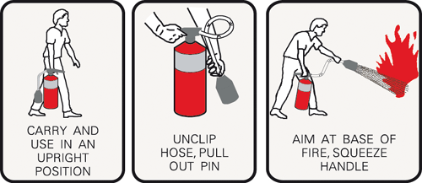
How to use a fire extinguisher:
Remember PASS
P- pull the pin and hold the fire extinguisher with the nozzle away from you
A- aim low
S- squeeze the lever slowly and evenly
S- sweep the nozzle side to side

Slide 11
What should you do if your clothes catch fire?
STOP, DROP AND ROLL
STOP The fire victim must stop still.
DROP The fire victim must ‘drop’ to the ground, lying down if possible, covering their face with their hands to avoid facial injury.
ROLL The fire victim must roll on the ground repeatedly in order to extinguish the fire by depriving it of oxygen.
If the victim is on a rug or one is nearby, they can roll the rug around themselves to further extinguish the flame. If a fire blanket is at hand, that is also a good way to extinguisher the fire.

Slide 12
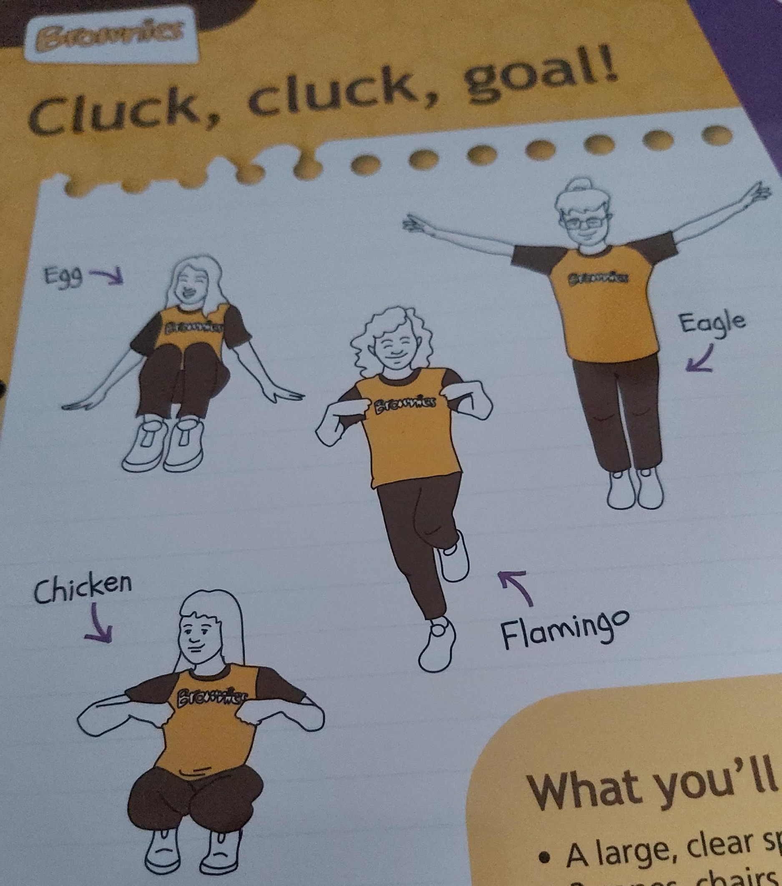
Cluck cluck goal UMA – Be well
How fast can you react in this game……
Egg
Chicken
Flamingo
Eagle

Slide 13
UMA Start with a bang - How the universe began
Do the biggest jump you can to show how the universe started with a big bang.
That was a huge explosion that created the universe 14 billion years ago.
The explosion caused everything to move outwards and get bigger – make it bigger by jumping backwards - do it in all directions if you can.
Then 300,000 years after the big bang the first atoms formed. Atoms are tiny particles so curl up as small as you can and roll around.

Slide 14
UMA Start with a bang - How the universe began continued
Now hop a few steps away from the middle of your space as 600 million years have passed since the big bang and the universe is even bigger.
Galaxies (group of stars) start to form – spin on the spot like you are a galaxy.
Take a giant step – nine billion years after the big bang the sun has formed.
It’s getting hot – act out getting hot.
Take another leap as the planets are being formed.

Slide 15
Lets act the planets - what action can we do for each one?

Slide 16
And finally we need
Moon – make the biggest circle you can
Comet – they spin round the sun and are made of frozen gas, rock and dust – make yourself into a unusual shape and spin around
Asteroid – small rocks than spin around the sun – make your self as small as possible and spin around

Slide 17
Cyclist says …
Before you start – check your ABC
Wear a cycle helmet
Wear a bright jacket
Look behind you before you stop
Signal left
Signal right
Ring your bell
Stop
Slow down

Slide 18
STOP UMA
STOP – to help you think and plan
Stop:
take a deep breath and review
Think:
How am I going to safely accomplish this task? What can possibly go wrong?
Observe:
What’s around you?
Whats in your pockets?
Where are you?
Who could help?
Plan:
what should you do next?
How will you do it?

Slide 19
STOP continued
The scenario 1
Questions to answer
You’re in the shopping centre with your mum or dad and your big brother.
You stop to tie your laces. When you look up your mum or dad is out of sight.
You’re lost.
What are you going to do?
Use STOP to help
Has this ever happened to me? –
How would I feel in this situation? –
What would I do?
What might happen next if I did that?
What other ways are there to solve this problem?

Slide 20
STOP continued
The scenario 2
Questions to answer
You’re in the park and one of your friends slips and hurts their leg.
Your mum has gone to buy ice-creams and you cant see her.
They cannot walk and are crying.
What do you do?
Use STOP to help
Has this ever happened to me? –
How would I feel in this situation? –
What would I do?
What might happen next if I did that?
What other ways are there to solve this problem?

Slide 21
STOP continued
Scenario 3
Questions to answer
You are walking home from school with your friends.
One friend suggests you take a shortcut through an alleyway.
Your mum has told you not to go that way.
You don’t want to disobey her but you don’t want to walk home on your own either.
What do you do?
Use STOP to help
Has this ever happened to me? –
How would I feel in this situation? –
What would I do?
What might happen next if I did that?
What other ways are there to solve this problem?

Slide 22
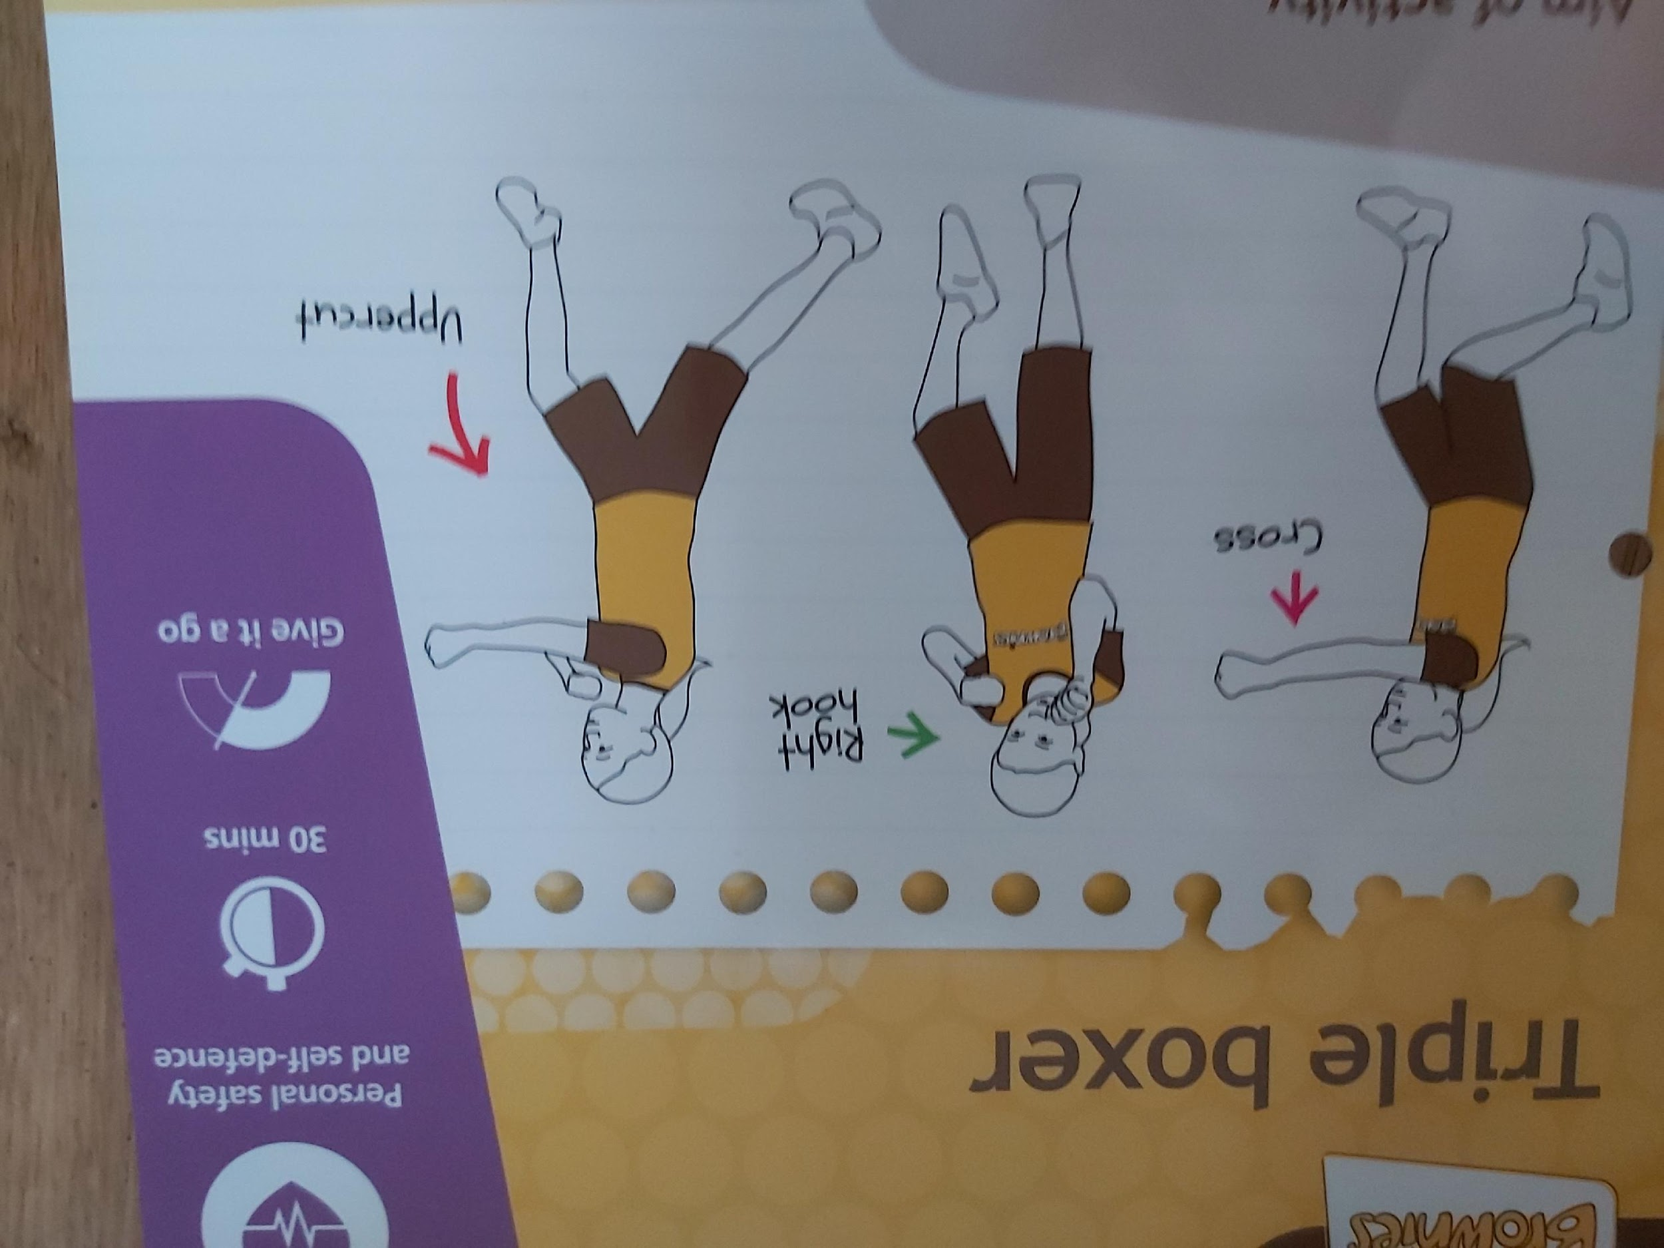
Triple boxer
Cross
Try the three moves

Slide 23
Triple boxer
Cross
Try the three moves

Slide 24
Coin challenge
Study the coins for 1 minute….
If you had one of each coin how much would it add up to?
How many different coins are there?
Which ones are not round?
Which is the smallest coin?
Who is on every coin?

Slide 25
1
2
3
4
5
6
7
8
9
10
Profits and pitfalls
You need a dice or choose a number from 1-6.
You have £20 – at the end of the game – how much do you have left?
20
19
18
17
16
14
13
12
11
15
21
22
23
24
25
26
27
28
29
30
END
39
38
37
36
35
34
33
32
31

Slide 26
Demanding designs
Your mission
All change
Design a new uniform for brownies. It needs
4 pieces of uniform
Have Brownies written on it
Be suitable for the UK
5 pieces of uniform
Must be suitable for hot weather
Must have a hat
Lets see the designs
How did you find the challenge?

Slide 27
Life cycle survival
Actions
To play the game
Egg – curl up on the floor
Caterpillar – crawl on the floor
Chrysalis – spin around
Metamorphosis - fly like a butterfly
Risk assess – is it safe?
When we call out a stage do the action
Make it harder- when we call out a stage act the next stage!

