Slide 1



Ideas for completing the skills builder for Rangers

Slide 2
You need 4 out of 5
Mass media means mass messaging - Social media, TV, magazines, films, advertising… the list goes on! We’re bombarded by media messages all day long! But how good are you at picking them apart and uncovering their hidden meanings? Time to find out…
Plain to see - Become a crystal-clear communicator and a jargon-busting champion as you give complicated text a wellneeded makeover!
Rhubarb and custard - It’s not just what you say that conveys information – it’s the way you speak too. Discover the power of your vocal chords to express your thoughts and feelings.
That's what I said - Why do we miscommunicate or misunderstand messages? Find out what journey an idea in your head goes on to be understood by someone else in this fast-paced, quicktalking activity.
Erm, like, y'know? - Everyone can, like, pause sometimes. And, at the end of the day if it happens a lot it can erm, be annoying for listeners. With some practice you can ditch these fillers and become a more eloquent presenter.

Slide 3
Mass media means mass messaging -
Social media, TV, magazines, films, advertising… the list goes on! We’re bombarded by media messages all day long! But how good are you at picking them apart and uncovering their hidden meanings? Time to find out…

Slide 4
What’s the message in the media
True or false
True or false
You can protect yourself from COVID-19 by injecting, swallowing, bathing in or rubbing onto your body bleach, disinfectants or rubbing alcohols.
These products are highly toxic and should never be swallowed or injected into the body. Disinfectants, bleach and soap and water may be used to clean surfaces, an important prevention step in stopping the spread of coronavirus and COVID-19 — the disease caused by the coronavirus that’s led to the global pandemic. Never attempt to self-treat or prevent COVID-19 by rubbing or bathing with bleach, disinfectants or rubbing alcohol anywhere on your body.
A vaccine to cure COVID-19 is available.
There is no vaccine for the new coronavirus right now. Scientists have already begun working on one, but developing a vaccine that is safe and effective in human beings will take many months.

Slide 5
What’s the message in the media
True or false
True or false
The new coronavirus was deliberately created or released by people.
Viruses can change over time. Occasionally, a disease outbreak happens when a virus that is common in an animal such as a pig, bat or bird undergoes changes and passes to humans. This is likely how the new coronavirus came to be.
Ordering or buying products shipped from overseas will make a person sick.
Researchers are studying the new coronavirus to learn more about how it infects people. World Health Organization (WHO) says that the likelihood of becoming infected with COVID-19 from a commercial package is low since it has likely travelled over several days and been exposed to different temperatures and conditions during transit.

Slide 6
What’s the message in the media
True or false
True or false
Coronavirus can ONLY be spread by touching someone
Coronavirus Disease (COVID-19) is caused by a virus. If you shake hands with someone and they have the virus on their hands and then you touch your eyes, nose or mouth, you can become infected. However, it can also spread from person to person through droplets when an infected person coughs, sneezes, breathes out or speaks. If you are standing near someone (within 1 metre) who has the virus, or you touch something they have touched and then touch your eyes, nose or mouth, you can become infected. People can also get coronavirus if they are standing close to someone who has the virus and they cough, sneeze or breathe on them.
When the weather is hot and sunny, you cannot catch coronavirus
You can catch COVID-19, no matter how sunny or hot the weather is - or how cold the weather is, for that matter. Countries with both hot and cold weather have reported cases of COVID-19. Keep to the key steps to protect yourself - stay at home, keep social distance and wash hands for 20 seconds with soap and water or, if that’s not possible, use hand gel

Slide 7
What’s the message in the media
True or false
True or false
I am young, so I won’t get coronavirus
Many young people seem to experience very mild or even no symptoms. Because people can have very mild symptoms, you cannot know whether you or anyone else has the virus and you cannot know whether or not you are passing it on to friends or family.
The source of coronavirus comes from 5G (mobile phone networks)
This is a conspiracy theory that is completely untrue and has been branded “the worst kind of fake news” by NHS England Medical Director Stephen Powis. 5G does not cause coronavirus and 5G does not transmit the virus. No one knows exactly what the source was, but it is believed to have come from a market in China where meat was sold alongside live animals such as chickens and bats

Slide 8
What’s the message in the media
True or false
True or false
I can catch coronavirus from someone who does not have any symptoms
While the risk of catching coronavirus from someone with no symptoms at all is very low, many people with the virus only experience mild symptoms. This is particularly true at the early stages of the disease. It is possible to catch coronavirus from someone who has, for example, just a little cough and does not feel ill.
Coronavirus can live on surfaces for up to several days
It is not certain how long the virus that causes COVID-19 survives on surfaces, but it seems to behave like other coronaviruses. Studies suggest that coronaviruses may live on surfaces for a few hours or up to several days. This may vary under different conditions (e.g. type of surface, temperature or humidity of the environment).

Slide 9
What’s the message in the media
True or false
True or false
There are things that I can do to help prevent the virus spreading
We all have a responsibility to do our bit to help prevent the virus spreading even more. We have been told by the Government to stay at home and only to go outside once a day for exercise, as well as to keep social distance (staying 2 metres away from other people). We should also reduce the number of times we go to the shops for essential items, such as food or medicines. We should stay in and not meet up with friends or family or go into other people’s houses.
There isn’t a cure for COVID-19
Currently, if someone gets COVID-19 there is no cure or specific treatment. For most people the body fights the virus and they recover after 7 to 10 days.

Slide 10
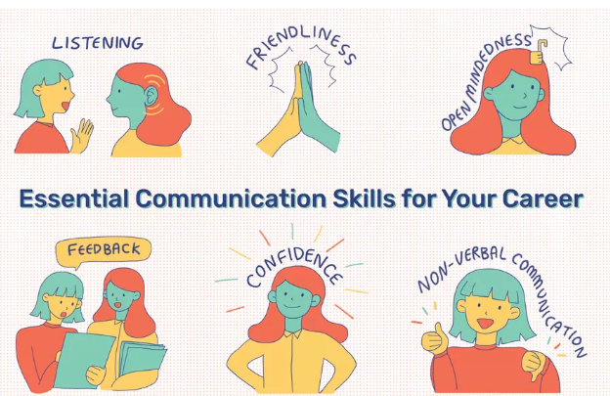
What’s the message in the media
Always check
Author - Who is the author
Reader - Who is it written for
Message – what’s it saying and how?

Slide 11

Spotting misinformation
The story – what are they trying to say? Is it an ad or a joke? Look to see if you can find the same story somewhere else
The author – is it someone’s opinion or a fact? Real news will most likely have a link to the writer’s details, but if there’s no author, dig deeper
The website – are there spelling or grammar mistakes? What’s the URL? Check the address bar at the top – most trusted URLs end with “.com”, “.co.uk”, “.net”, “.gov”, “.org”, “.mil” and “.edu”
The date – is the story recent or old? It could be outdated or a copy of something that happened years ago. Computer programs called bots post anytime and often, so be wary of this.
https://www.bbc.co.uk/news/blogs-trending-52474347

Slide 12
Erm, like, y'know?
- Everyone can, like, pause sometimes. And, at the end of the day if it happens a lot it can erm, be annoying for listeners. With some practice you can ditch these fillers and become a more eloquent presenter

Slide 13
Fillers
Name some fillers
Why do we use them?
Err
Yep
OK
Time to think

Slide 14
Talk for a minute
Brainstorm topics
Lets play… talk for a minute
TV shows
Italian food
Things I’d change in the world
Choose a topic
Talk for a minute
You are out if you
Hesitate
Deviate – go off topic
No fillers

Slide 15
Rhubarb and custard
- It’s not just what you say that conveys information – it’s the way you speak too. Discover the power of your vocal chords to express your thoughts and feelings.

Slide 16








Take it in turns to make the sound of these emojis Can the others guess which one, and do they agree?
Notes:
Rhubarb and custard SB
Communicate without words

Slide 17
GAME
Our words do not always show what we mean or how we feel.
Can you spot the tone in this game?
Split the into 2 teams.
Each team member will have 1 go to choose one box from each column. They must act out both boxes to their team, by only using the words in their column A box with NO ACTIONS.
The team has 20 seconds to guess which box from column B is being acted out.
If guessed correctly, the team will earn 1 point.
If no correct guess is made, the opposing team can make 1 guess and if they guess correctly they’ll earn 2 points.
Column A EXAMPLE: Column B
“I’m feeling great today!”
Unhappy
Notes:
No actions or facial expressions…. It’s all in the voice!

Slide 18
A B
“I’m feeling great today”
“I’ve just had made something for dinner”
Happy
Excited
Inquisitive
Argumentative
I’ve just got back, I’ve got a lot to tell you, please let me know when you’re free.”
“I’m coming”
Exasperated
Frustrated
“I’m ok, how are you?”
Deceptive
Confused
“School was ok I guess, a lot happened”
“Just finished my homework”
Shy
Sad
Proud
“Ok, ok, just don’t forget alright? It’s very important”
Disappointed
Angry
“I’m not feeling too well”
Lonely
Scared
“Great… that’s fab”
“Yeah of course”
Tearful
Shocked

Slide 19
Choose a scenario and see if the rest of us can guess which one you are doing? Here's the catch … you are only allowed to say RHUBARB!
Hint: try changing your tone, pitch and volume
Trying to teach someone how to use a laptop, who doesn’t know how.
Helping a friend who hasn't done their homework
Ordering something from Mcdonalds
Trying to sell someone something.
Finding out what time the train leaves the station
Giving someone directions to the cinema
Explaining the story of little Red Riding Hood
Being angry about something
Asking your teacher for help in school
Notes:
Rhubarb and custard SB
Communicate without words

Slide 20
That's what I said
- Why do we miscommunicate or misunderstand messages? Find out what journey an idea in your head goes on to be understood by someone else in this fast-paced, quicktalking activity.

Slide 21
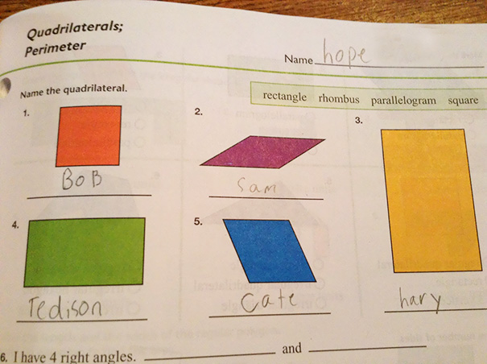
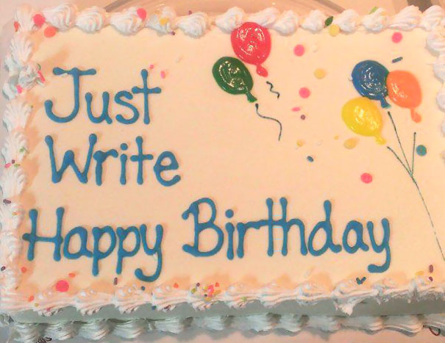
Where do you think the miscommunication happened in these photos?
Notes:
Rhubarb & custard skill builder - reflect on misunderstandings happening
Questions to ask:
How can you change the question so the same mistake doesn’t happen?
Who make the mistake the person giving the instruction or the person answering?
Do you think it happen genuinely?

Slide 22
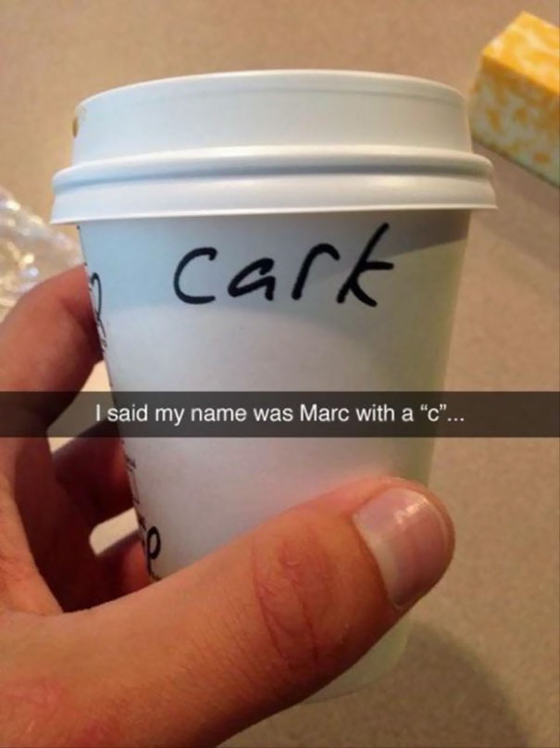
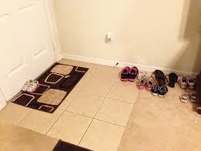
Notes:
Questions to ask:
How can you change the question so the same mistake doesn’t happen?
Who make the mistake the person giving the instruction or the person answering?
Do you think it happen genuinely?

Slide 23
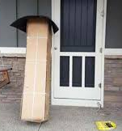
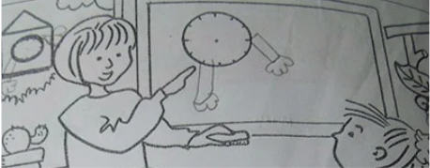
Notes:
Questions to ask:
How can you change the question so the same mistake doesn’t happen?
Who make the mistake the person giving the instruction or the person answering?
Do you think it happen genuinely?

Slide 24
Plain to see -
Become a crystal-clear communicator and a jargon-busting champion as you give complicated text a wellneeded makeover!

Slide 25
Can you simplify these bits of text so they are easy to understand?
You might want to think about:
Tense
Jargon
Simplification
re-wording
The Terms form a legally binding agreement between you and us. Please take the time to read them carefully. If you are under age 18, you may only use the Services with the consent of your parent or legal guardian. Please be sure your parent or legal guardian has reviewed and discussed these Terms with you.
-Tiktok
Notes:
Plain to see SB

Slide 26
Charges will be made for the damage of equipment during the hire period. The charge will not be greater than the total cost of a replacement tent or a specific item. If the amount to be charged is greater than the value of the security deposit, the hirer agrees to pay for all the costs incurred in repairing/replacing the equipment.
-pitch my tent (Terms and conditions)
You might want to think about:
Tense
Jargon
Simplification
re-wording

Slide 27
Individuals acting on behalf of a commercial enterprise, governmental organization or educational institution (an “Enterprise”) may download and sync non-Arcade Apps for use by either (i) a single individual on one or more devices owned or controlled by an Enterprise; or (ii) multiple individuals on a single shared device owned or controlled by an Enterprise. For the sake of clarity, each device used serially or collectively by multiple users requires a separate license.
-Apple
You might want to think about:
Tense
Jargon
Simplification
re-wording

Slide 28
Dear parents,
I hope you and your family are well at this difficult time. We’re really enjoying meeting your daughter virtually. It’s the highlight of our week to bring some normality to these times and give your daughter/ward an opportunity to do something different.
You might want to think about:
Tense
Jargon
Simplification
re-wording
Subs payments
It’s difficult to talk about money during this time as many of you would’ve been affected by the current circumstances. I’m writing to you to explain that for us to keep the unit open we still need to cover our costs.
As you know you currently pay subs weekly. This covers two separate costs. Part of the subs is used to run the unit. This includes unit activities, paying hall rent, paying for programme materials and badges, equipment and to pay for any leadership training that we have to attend to make sure meetings are run safely.
The other part is used to cover the annual subscription (sometimes known as census) which we pay Girlguiding HQ in February/March. This covers your daughter’s membership of Girlguiding and the guiding region, county, division and district we belong to. The money is used to develop the guiding programme and badges, including the current Adventures at home resources, insurance and safeguarding plus the costs of running our local area such as the rent on the county cottage at Cudham.
Girlguiding template – subs letter 2020

Slide 29
Resources
https://www.bbc.co.uk/beyondfakenews/
http://www.plainenglish.co.uk/
https://www.bbc.co.uk/bitesize/guides/z8ydv4j/revision/4
https://www.youthemployment.org.uk/teachers-resources/careers-education-presentations/

