Slide 1
Guide UMA ideas
The resources you need – pen and paper!
You may need scissors and Sellotape/bluetack/paper clips for a couple of them.

Slide 2
Washing line of pride
In patrols have a chat about your favourite Guiding moments – it can be from Guides or from other sections….
What was fun?
What was challenging?
What are your proudest moments?

Slide 3
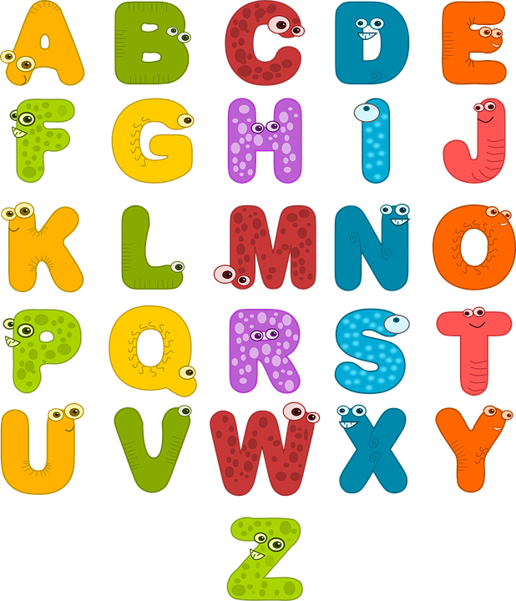
Washing line of pride continued
For each letter of the alphabet come up with something that you are proud of achieving in Guiding

Slide 4
Washing line of pride continued
For each letter of the alphabet come up with something that you would like to do in Guiding

Slide 5
Against the Law
The challenge
The Guide Law
Which Law has been easiest to keep as a patrol this week?
Why?
A Guide is honest, reliable and can be trusted.
A Guide is helpful and uses her time and abilities wisely.
A Guide faces challenge and learns from her experiences.
A Guide is a good friend and a sister to all Guides.
A Guide is polite and considerate.
A Guide respects all living things and takes care of the world around her.

Slide 6
Against the Law continued
The challenge
The Guide Law
Which Law has been hardest to keep as a patrol this week?
Why?
A Guide is honest, reliable and can be trusted.
A Guide is helpful and uses her time and abilities wisely.
A Guide faces challenge and learns from her experiences.
A Guide is a good friend and a sister to all Guides.
A Guide is polite and considerate.
A Guide respects all living things and takes care of the world around her.

Slide 7
HELP
What to do
Learn the positions
You may need to change the action for Sinking
Ask someone to call them out
How fast can you play this without anyone getting out?

Slide 8
Paper pilots
Activity
Create a plane
Fly it – measure how far it goes
Add a paper clip or a piece of bluetack – fly it again – what happens?
Keep experimenting and moving the bluetack
Create top tips for others

Slide 9
No doubt
Activity 1
Activity 2
write three things you think you can’t do or have doubts about trying but want to give a go, or even dream of getting really good at.
For example, ‘I can’t pass my maths test,’ or ‘I can’t skateboard.’
In your patrol share one doubt
Help each other to identify three truths to help you overcome your doubts.
For example, ‘I can find a study buddy to revise with for my maths test,’ or ‘I can ask my friend to help me learn to skateboard.’

Slide 10
Props to you UMA
You are going to tell a story –
Find two items and put in a bag/pillowcase so no one knows what they are
One person at a time, unmute and tell us one sentence of the story using one of your props – you can either use it as it as it is or as an imaginary object eg a banana as a fruit or as a phone.
The first sentence of the story is:
The Guides were going on an outing. They had all been told to bring a lettuce. (leader holds up a ball)
Notes:
19:45

Slide 11
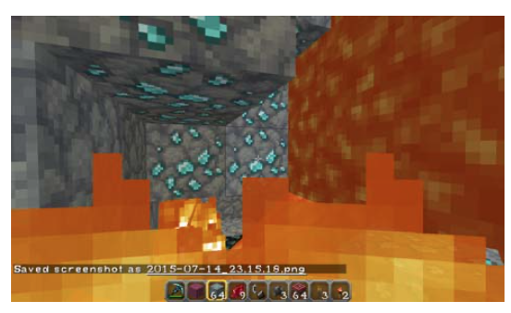
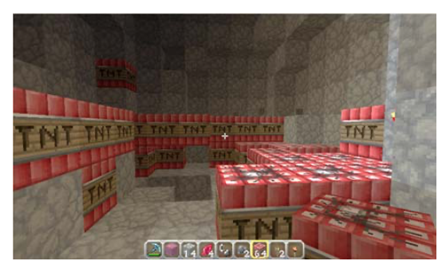
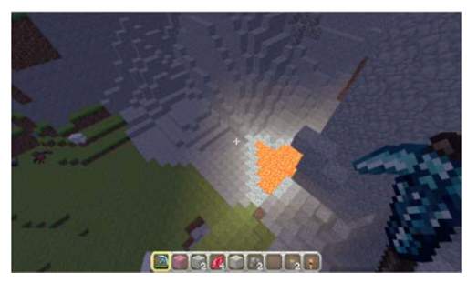
Stor-elay
Steve had lots of trouble finding diamonds and other ore to make tools and weapons.
Legend says that diamonds can be found near lava flows. That is where you start digging. The lava is all around you and you start to feel really hot but you can’t give up yet. You move to the left, to the right, you dig up, down, under and over using your trusted diamond pickaxe. Your pickaxe begins to wear down, and so do you. You have to find a better, easier way to find diamonds. You check your inventory and it looks like you have plenty of dynamite.
What do you do next? Write a paragraph to finish the story. Try and do it in 6 sentences….using the words on the next slide
Notes:
19:25

Slide 12
Stor-elay UMA
Firstly
Suddenly
Luckily
However
Finally
In the end

Slide 13
Pass it on
In patrols
ONE OF YOU think of a story with a twist eg making pancakes and when you toss it, the pancake flies out of the window onto someone's head.
Player one and two stand up – everyone else turn away from the screen
Player one mimes the story to player two
Player two then mimes the story to player three
Keep going until you have mimed it to everyone in the patrol
The last player mimes it to player 1
What was the same?
What changed?

Slide 14
Surfs up

Slide 15
Surfs up

Slide 16
Bank or bust UMA
How many currencies can you name?
How many different payment methods can you name?

Slide 17
Did you have …. 108 currencies
The 22 dollar currencies are
The euro is the currency of 19 countries:
the Australian dollar, the Bahamian dollar, the Barbadian dollar, the Belize dollar, the Bermudan dollar, the Brunei dollar, the Canadian dollar, the Eastern Caribbean dollar, the Fijian dollar, the Guyana dollar, the Hong Kong dollar, the Jamaican dollar, the Liberian dollar, the Namibian dollar, the New Zealand dollar, the Singapore dollar, the Solomon Islands dollar, the Surinamese dollar, the Taiwanese dollar, the Trinidad and Tobago dollar, and the now defunct Zimbabwe dollar.
Austria, Belgium, Cyprus, Estonia, Finland, France, Germany, Greece, Ireland, Italy, Latvia, Lithuania, Luxembourg, Malta, the Netherlands, Portugal, Slovakia, Slovenia, and Spain. The European microstates of Andorra, Monaco, San Marino, and Vatican City have also adopted the euro, as well as Kosovo and Montenegro as a de facto currency.

Slide 18
Bank or bust
How many ways can you keep your money safe?

Slide 19
Bank or bust
Methods
Can you
Cash
Cheque
Credit card
Debit card
Direct debit
Electronic fund transfer
Standing order
Define each method
Come up with 1 advantage and 1 disadvantage

