Slide 1


XXX Guides
Digital Passport
Where have we been this year?
Guiding is part of an international family of 10 million Girl Guides and Girls Scouts from around the world. Whilst travelling is amazing we can still learn about other countries, the people who live their, their traditions, history, culture.
This digital passport is a record of all the countries our unit has ‘visited’ this year – whether tried a craft, watched a video, learnt about something, met some who has live there, tried some traditional food, investigated what is grown or made their, found out about the lives of people who live there.
The world is an amazing place and this is our record of where we have virtually travelled
Notes:
Leaders – duplicate a slide for each country you have ‘visited into this slide deck so at any point you can share with the girls and families what you have done and why

Slide 2
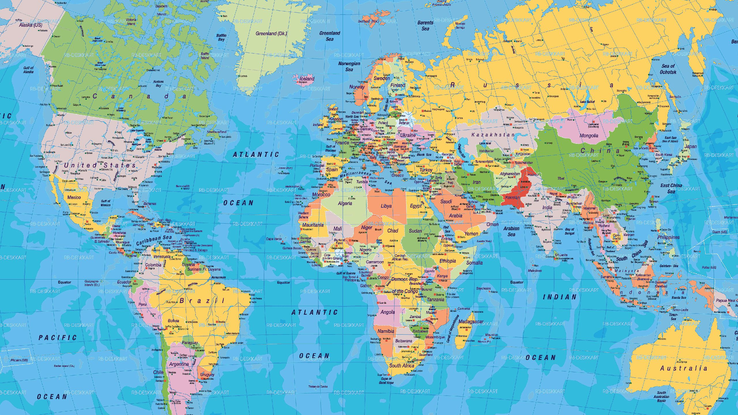

Slide 3


Slide 4
Country Name
Why did we go?
What did we do?
Flag of country
map
Dates of our visit:
Notes:
Leaders – use this template or create your own – Swap the logo to your own unit and then add what ever detail you want.

Slide 5



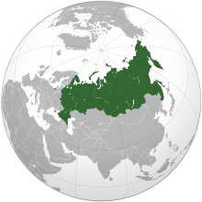
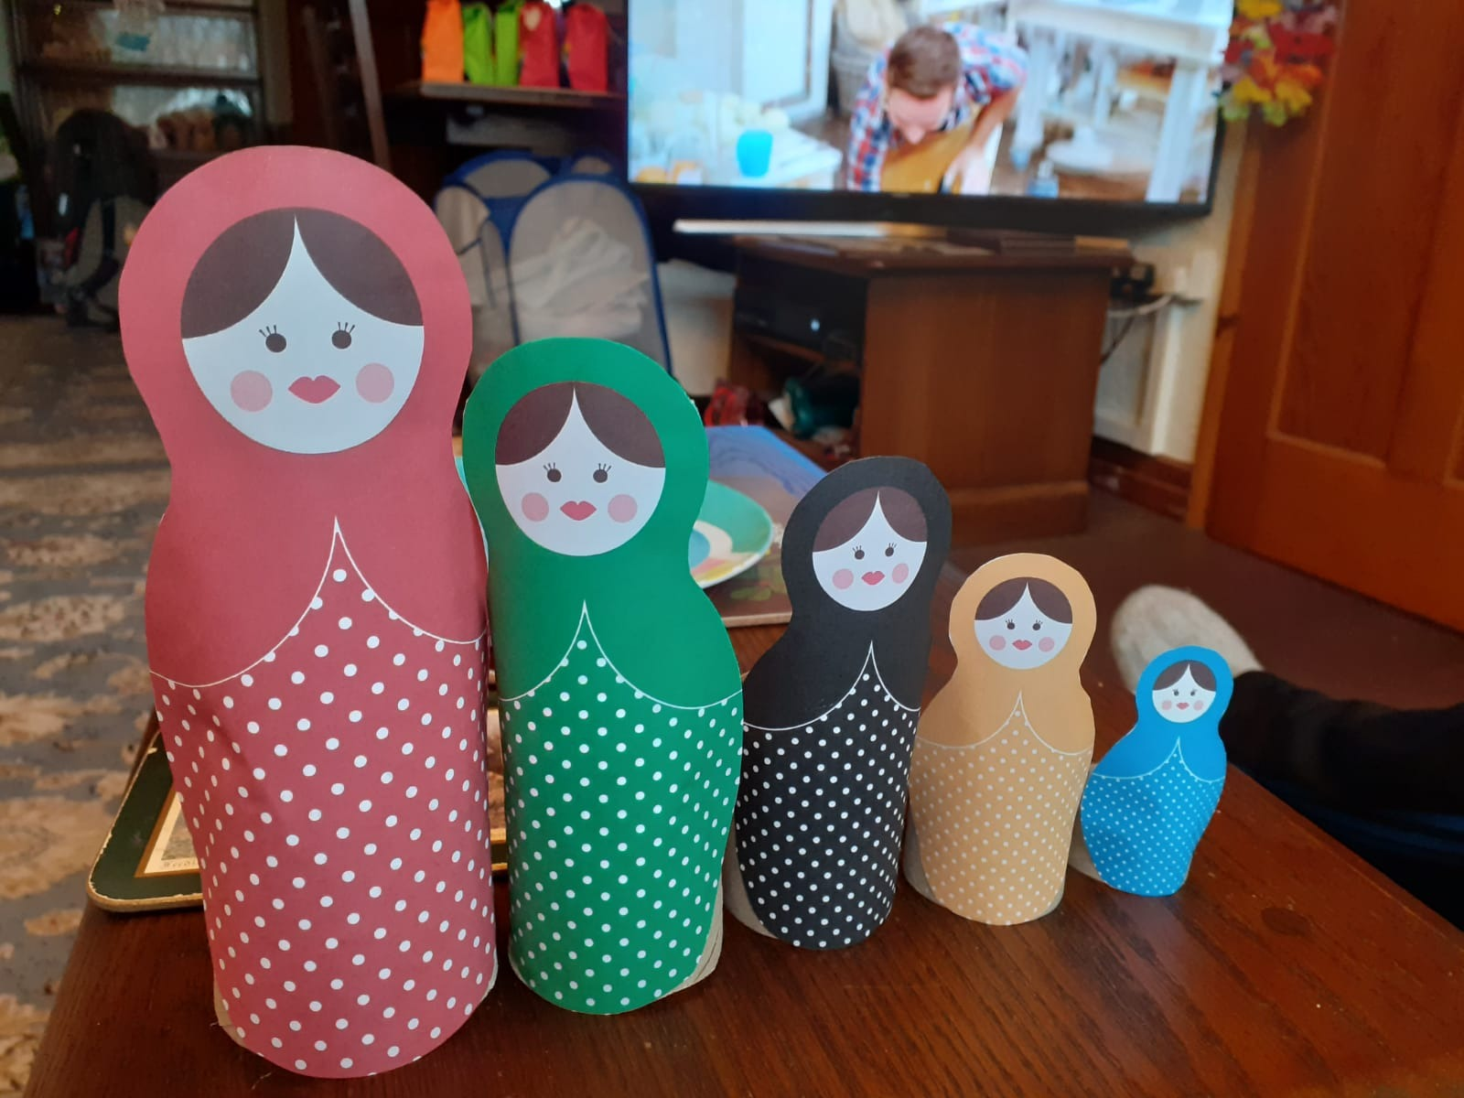
Russia/ Soviet Union
Whilst exploring Space travel and the planets, as part of our Shoot for the Moon challenge, we found out about Russian Astronauts who went into space including the first women in space, called Valentina Tereshkova. We also found out about the Mir Space station and we created our own Russian nesting Dolls
Russia back in the 1960/70/80s was part of the Soviet Union
The flag of the Soviet Union which is what is was called when they were leading in space travel which we learnt about
Current Russian Flag
Dates of our visit:
22nd and 29th Jan and 5th Feb 2021
Notes:
This is just a couple of examples which you can delete

Slide 6


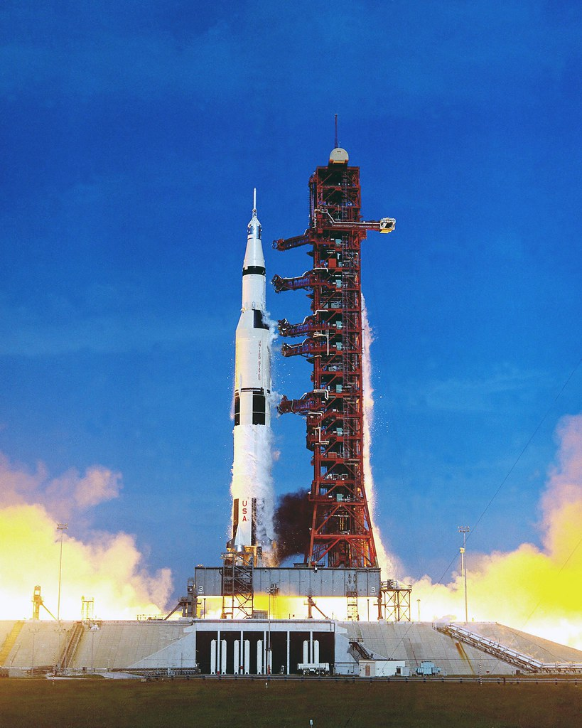
USA
Whilst exploring Space travel and the planets, as part of our Shoot for the Moon challenge, we found out about the role of the United States in space travel including the Apollo missions to the moon.
We tried some NASA (National Aeronautics and Space Administration) activities
Dates of our visit:
22nd and 29th Jan and 5th Feb 2021

Slide 7

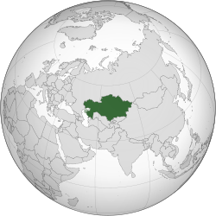
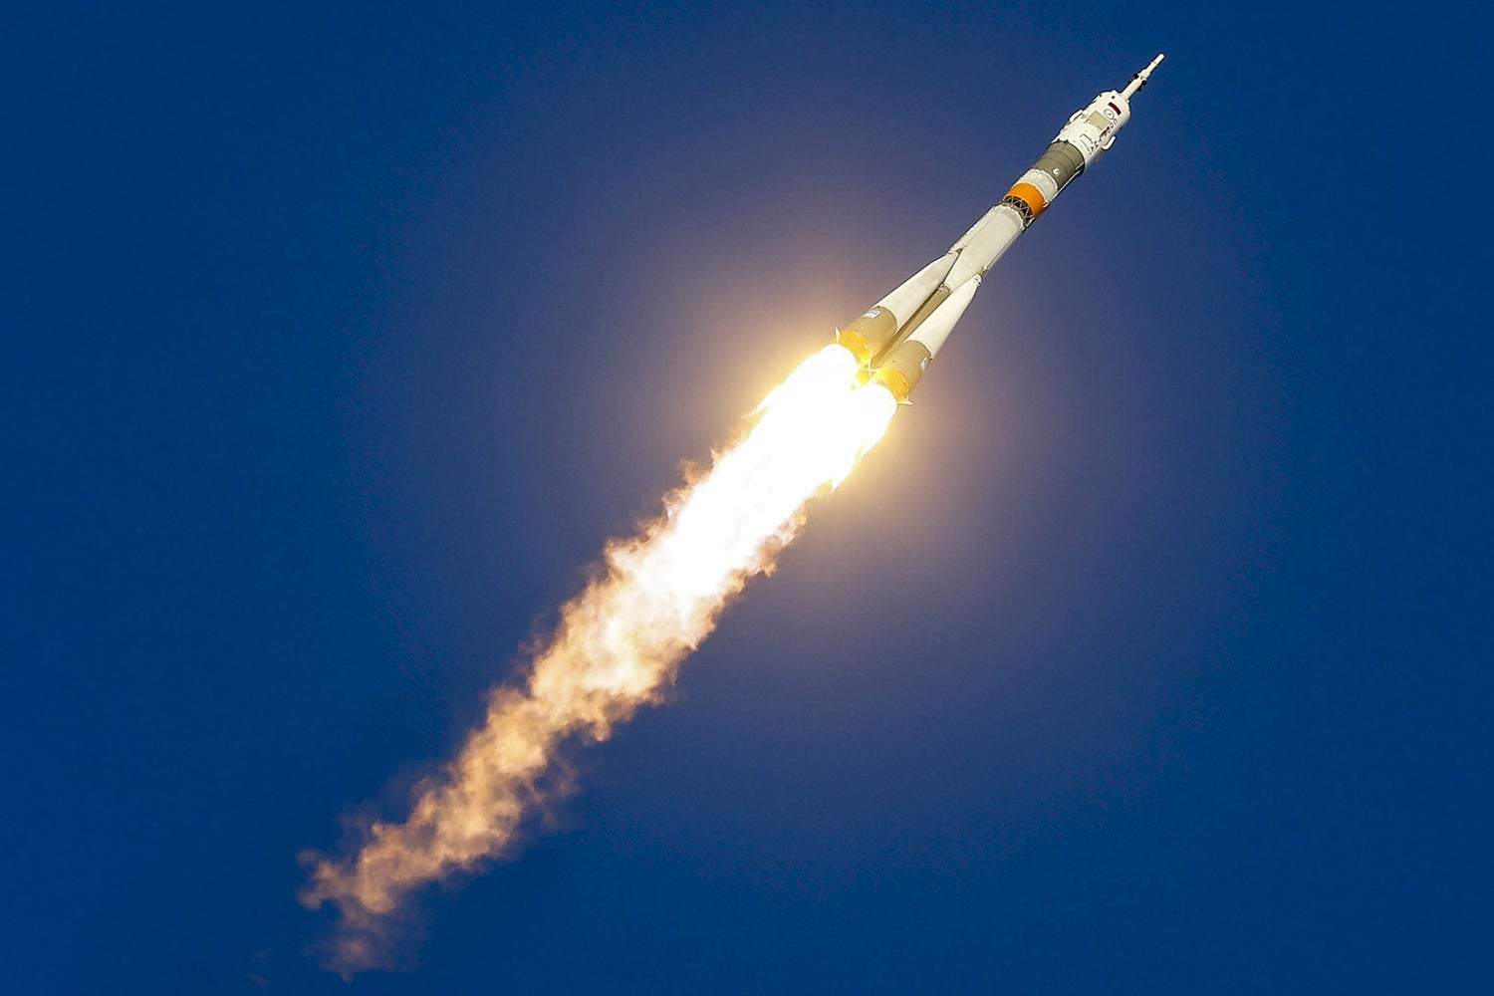
Kazakhstan
This was the launch site for Tim Peake’s mission into space in 2015. We watch the video of the launch as part of our Shooting to the Moon challenge .
He launched from Baikonur Cosmodrome which is in Kazakhstan but leased to the Russian Government for all space launches. (The first man in space Yuri Gagarin also took off from here)
Dates of our visit:
29th Jan 2021

