Slide 1

Packaging Logos
How much do you know?
Can you pair up these logos with what they stand for

Slide 2

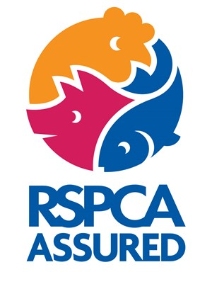



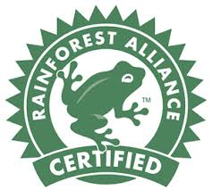
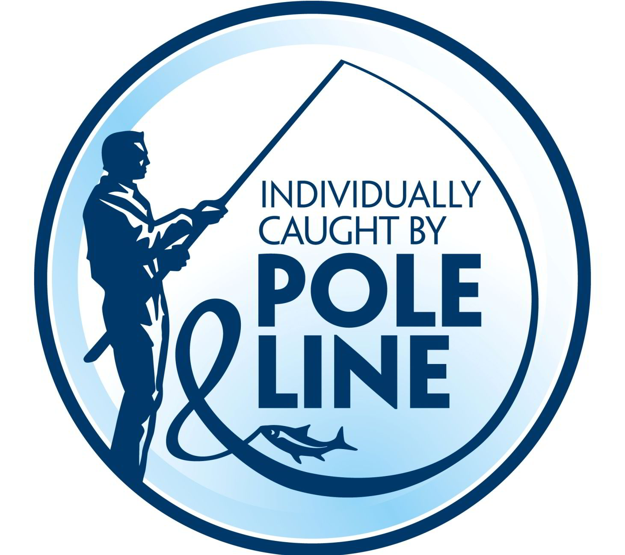
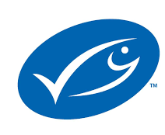


Must have access to outside for at least part of the day
Produced without using chemicals
Meets standards to reduce dolphin deaths during fishing
Food has been produced responsibly
All farm animals live a good life and are treated without cruelty
Encourages sustainable fishing
Caught while minimising harm to other marine life
Improves the sustainability of tea faring and the lives of workers
Sustainably farmed
Aiming to conserve biodiversity and create healthy communities
Notes:
Move them around according to what the group tells you until they are paired up

Slide 3
The Answers

Slide 4
All farm animals live a good life and are treated without cruelty
Sustainably farmed
Produced without using chemicals
Must have access to outside for at least part of the day
Food has been produced responsibly
Improves the sustainability of tea faring and the lives of workers
Aiming to conserve biodiversity and create healthy communities
Encourages sustainable fishing
Caught while minimising harm to other marine life
Meets standards to reduce dolphin deaths during fishing

Slide 5
Which of the labels matches these benefits
Improves safety and Hygiene standards
Animals are protected
Local people are protected to have a good quality of life
Less pollution is produced
Less food goes to waste

Slide 6
Improves safety and Hygiene standards
Animals are protected
Local people are protected to have a good quality of life
Less pollution is produced
Less food goes to waste
Notes:
Get them to draw lines or tell you to according to which they think match each logo

