Slide 1
Rainbow UMA ideas
All of these can be done with minimal supplies - pen and paper. You may need some scissors and Sellotape or glue for a couple of them.

Slide 2
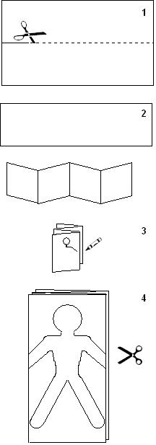
Guiding and me - Know myself 30 mins
Take a piece of paper and cut it lengthwise.
Fold it into quarters fan (pleated) style.
Draw a figure of a person on the top layer. Be sure that the arms extend beyond the edge of the folded sheet.
Cut the figure out and unfold. You will get a chain of dolls holding hands

Slide 3
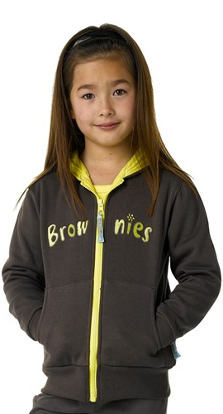
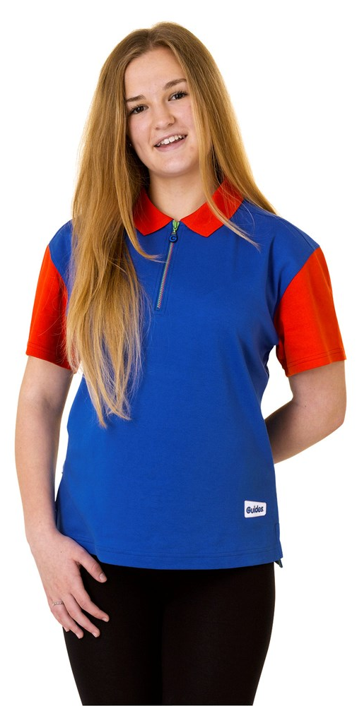
Lets colour in for our 4 sections

Slide 4
A rainbow odyssey Know myself 20 mins
Iris
Hypnos
Iris was known as the goddess of the rainbow and another messenger for the gods in Greek mythology. She is depicted as a beautiful golden goddess, with wings (for flight), sandals, a staff, and a tunic.
How could we act what she did? Could we draw rainbows in the sky?
Hypnos is the god of sleep in Greek mythology.. ... Hypnos was represented as a gentle young man, usually with wings attached to his temples or shoulders.
How could we act what he did? Could we curl up on the floor and pretend to sleep?

Slide 5
A rainbow odyssey continued
Demeter
Hestia
Greek goddess of the harvest, grain, and crops.
How could we act what she did?
Goddess of the home and hearth (fireplace).
How could we act what she did?

Slide 6
A rainbow odyssey continued
Choose one of the Gods
Name 10 things
Act it out
Let’s guess who you are
Ready steady go…
Let’s name 10 things that were not around in ancient Greece eg mobile phones…..

Slide 7
Swimming to safety Be well 15 mins
Cold water – bunny hop around
Warm water -time to swim
Strong current – spin in circles
Tides coming in – make whooshing noises and whoosh back to shore
Sun out – rub in the suncream

Slide 8
Great greetings – Skills for my future 30 mins
BELIZE | Press fists together.
JAPAN | Bow from the waist.
RUSSIA | Kiss three times, on alternate cheeks...left, right, left.
NEW ZEALAND (Maori) | When the Maori people greet each other, they press their noses together. This custom is called hongi.
BOLIVIA | The Aymara women in Bolivia says hello to a friend with a tip of her bowler hat.
ITALY | In Italy, friends greet each other by saying, "Ciao."
FIJI | Men are expected to say "oooo" when greeting their chief.
ISRAEL | Shalom means hello in Hebrew
INDIA | Hands together as in prayer and bow
INUITS | Rub noses together
ROYALTY | Curtsey - female

Slide 9
Topsy Turvy Art – Express myself 20 mins
Choose 3 colours
Take a sheet of paper and start colouring. It doesn’t matter which colours go where. Have fun creating shapes with your colours.
Now you have coloured it – have a look what shapes can you see – add the outline
Its topsy turvy art
Notes:
Think about when you draw a picture. What do you normally do first? Most likely, you draw the shape of your picture. This is called an outline. You might do this using a pencil, then colour it in. We’re going to turn it all topsy-turvy.
Take a sheet of paper and start colouring. It doesn’t matter which colours go where. Have fun creating shapes with your colours.
Now you’ve created the fill for your picture, draw an outline – it could just be a big squiggle on the page! Once you’ve added an outline can you decide what your picture is? Perhaps it looks like a building, a cat or a pond. Add more details to show off your shape.
Finished? Show off your topsy-turvy creations in the bizarre art gallery. This is where the pictures get put on the floor instead of the walls. Look at everyone else’s amazing artwork, can you guess what they drew? Be careful not to tread on the masterpieces!

Slide 10
Secret strength Skills for my future 30 mins
Square column
triangular column
Fold one piece of paper in half
Fold each end in half again towards the centre fold,
Your paper is split into four even segments.
Fold the paper into a square and secure with tape.
Fold the second piece of paper into thirds to create a triangular column
Tape it together

Slide 11
Secret strength continued
CIRCULAR COLUMN
You should have 3 like this….
Tape the edges together to form a circular column.

Slide 12
Secret strength continued….Which is strongest?
The task
Did you have?
Stand each column up and carefully place books on top of each one.
Use the same books in the same order until the column collapses.
Record how many books each column holds.
Remember to use the same books in the same order and the same size paper for each column.

Slide 13
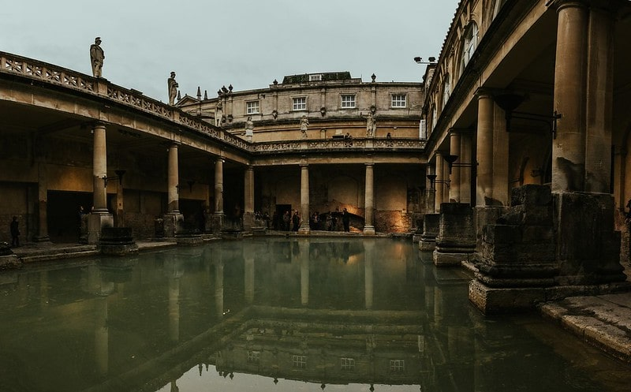
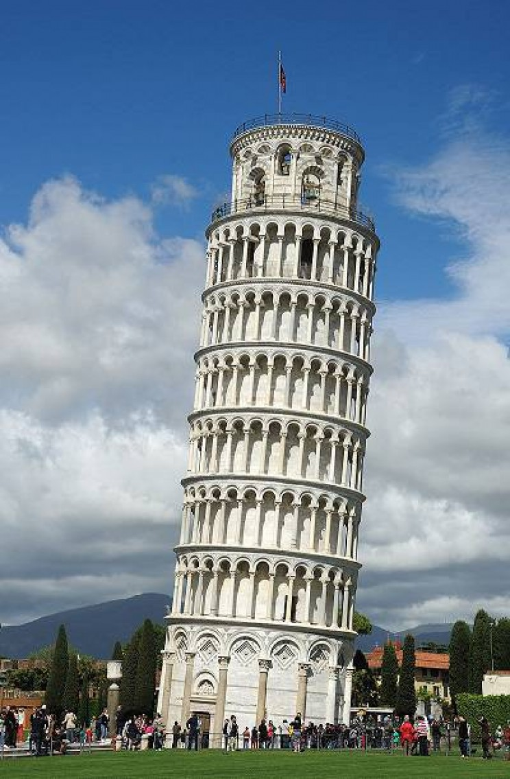
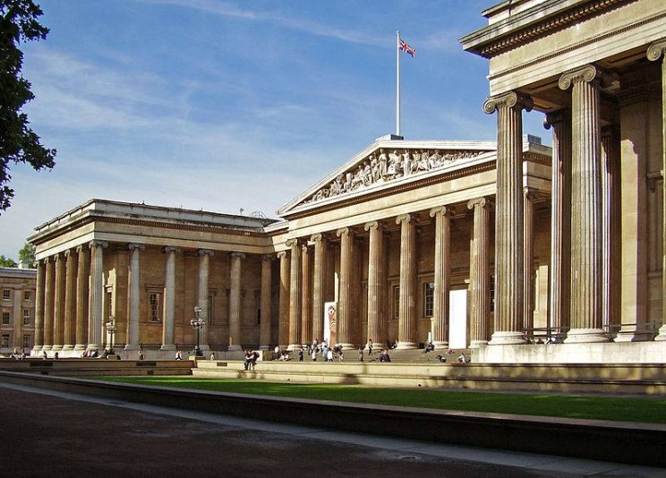
Secret strength continued…. RESULTS – STRONG SHAPES
Circular column
Where have you seen columns in real life?
the circular column is the strongest.
This is because it doesn’t have any edges so the weight of the books is shared evenly by the circle.
The square and triangle support the books on their edges and corners meaning they collapse.

Slide 14
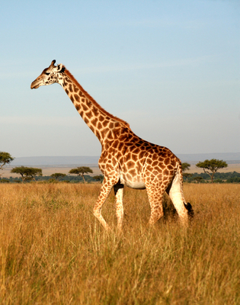
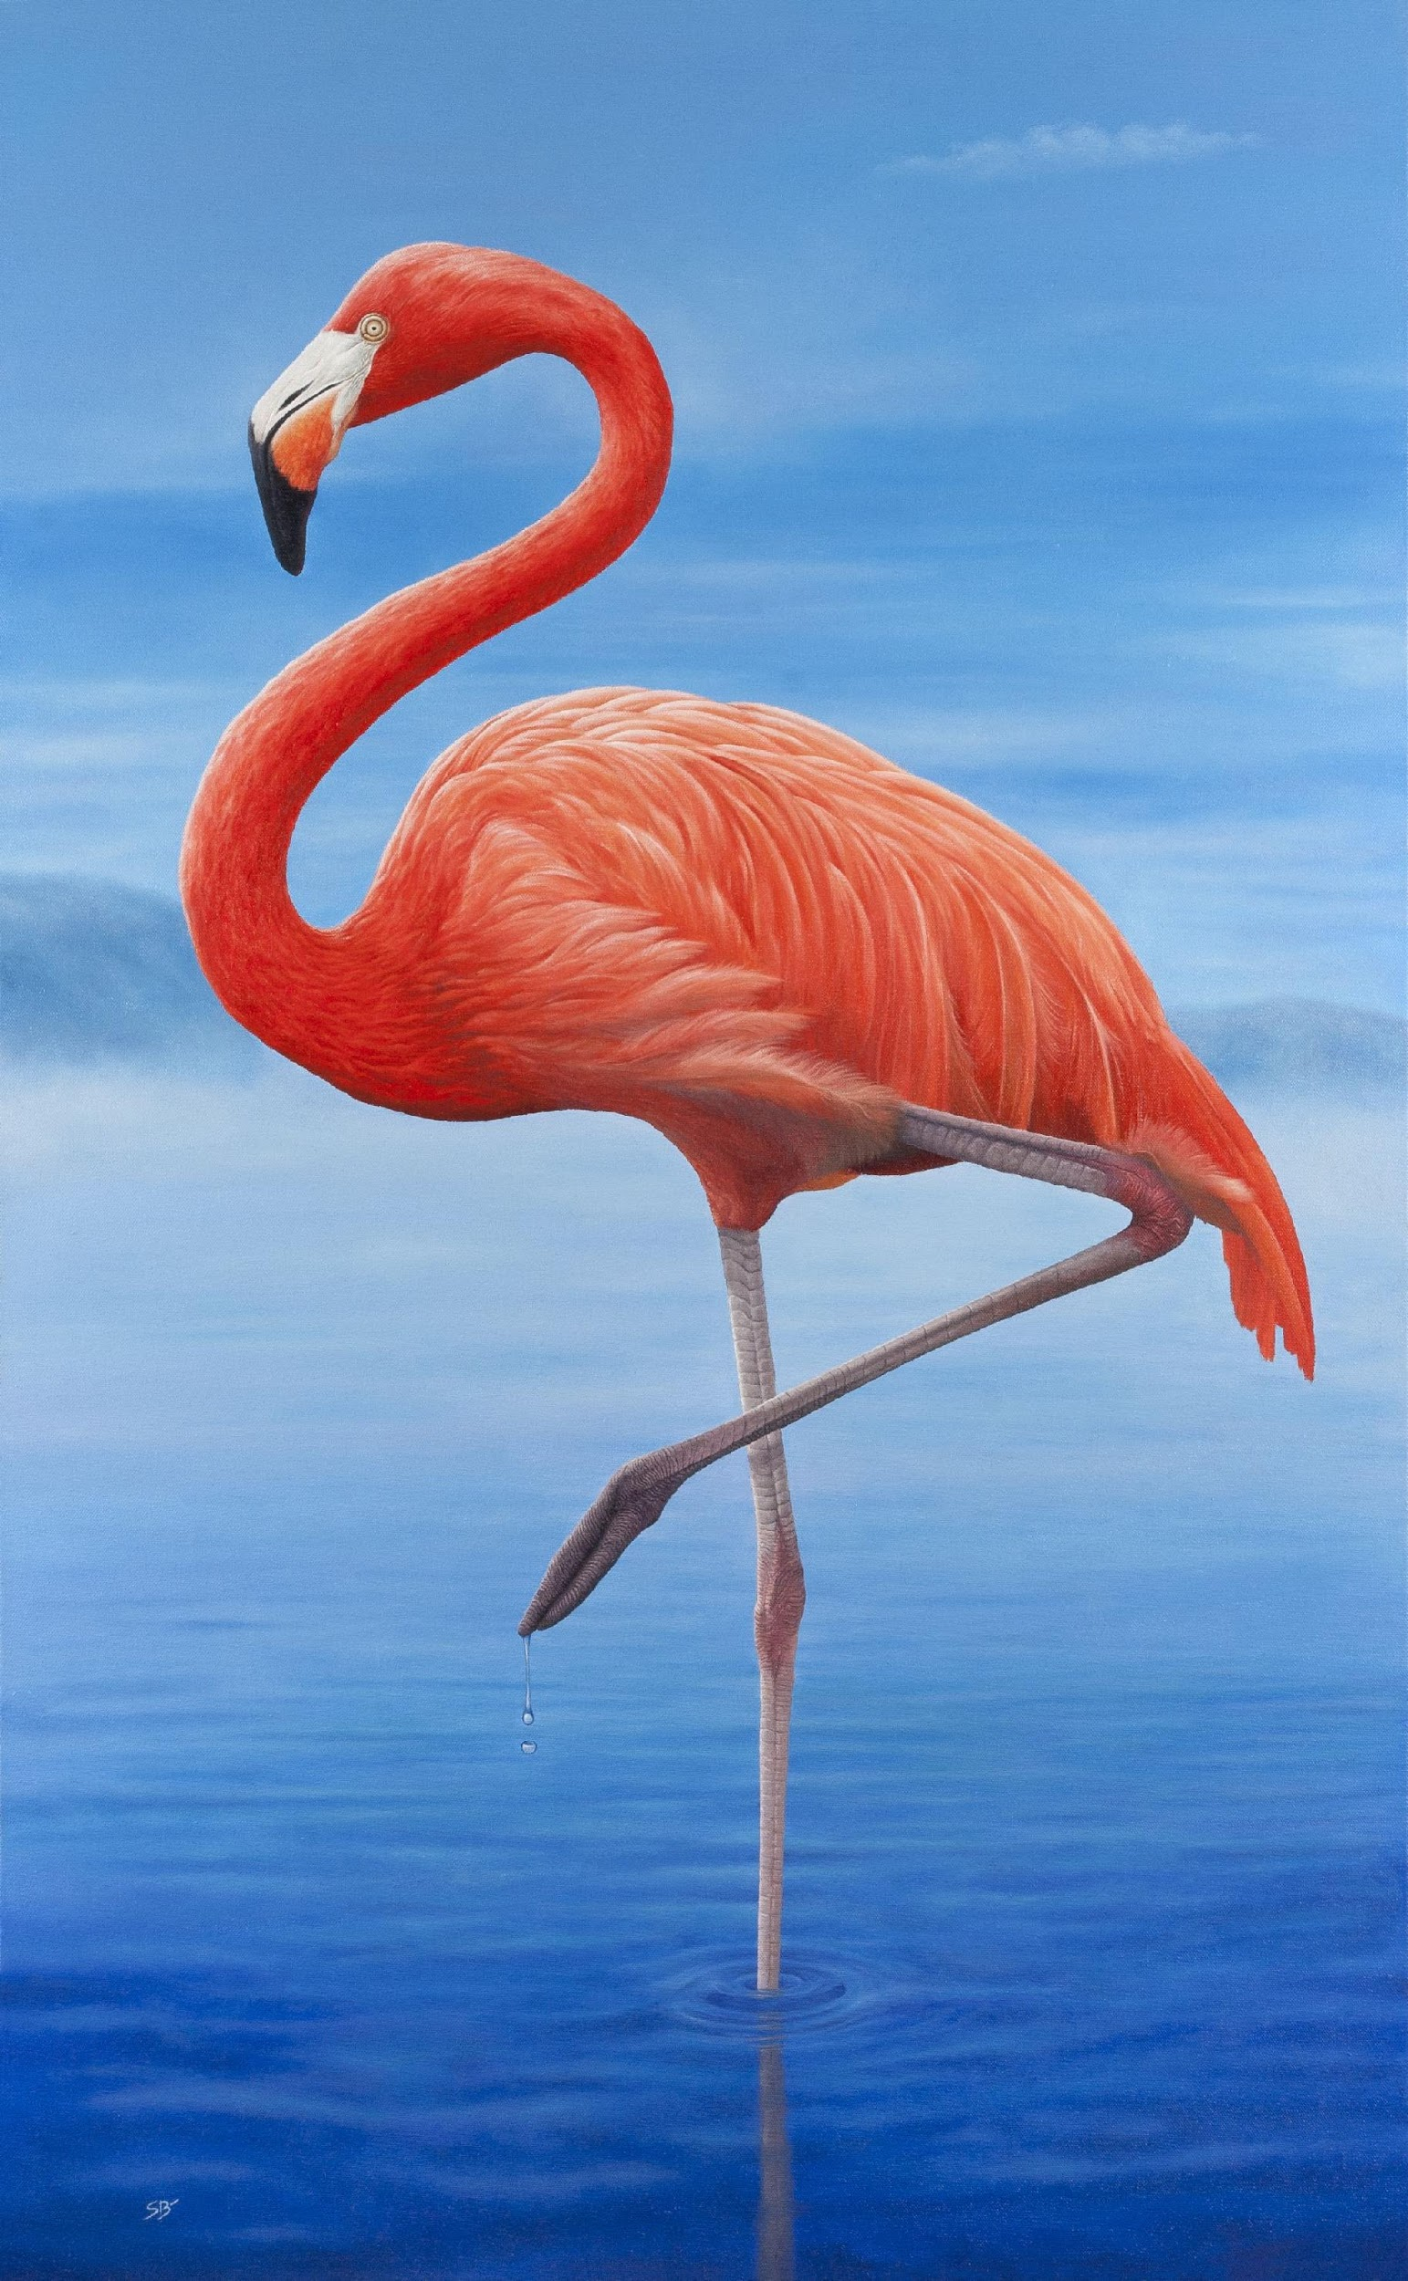
Pedal power – Be well 30 mins
Giraffe – stand on your tippy toe
Flamingo – stand on one leg
Monkey – sit with only your bottom touching the floor
Listen to the story read by your leader and do the correct action when the animal is said.

Slide 15
Safety comes first Skills for my future 15 mins
Let’s practice the actions
Let’s listen to the story and do the actions in the right places
How do you think Rosie felt when she lost all her money?
Where could Rosie have kept her money safe?
Notes:
Leader needs UMA card to read story

Slide 16
Higher or lower – Skills for my future 10 mins
Stretch as high as you can if you think it costs more than the item before it
If it’s less get as close to the floor as you can
Is a house more or less than a loaf of bread?
Bar of chocolate more or less than a house?
A car more or less than a chocolate bar?
A pint of milk more or less than a chocolate bar?
A holiday more or less than a pint of milk?
A bunch of bananas more or less than a holiday?
New shoes more or less than bananas?

Slide 17
Lovely losers – Be well 30 mins
Rock paper scissors
If you are the same as the leader calling you win!
Who can get to 5 wins first?

Slide 18
Splat bang zoom – Express myself 20 mins time
What does onomatopoeia mean?
Squelch – you’re in the mud
Bubble – lets float softly
Hiss – slither like a snake
Bang – jump up
Boing – jump up and down
What other words could we add with a movement?

Slide 19
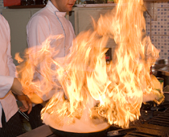
Splat bang zoom continued
The fire
When Carly Eats Spaghetti
was hot
Crackled
Was red
When Carly eats spaghetti,
She chomps and gobbles and slurps,
The spaghetti disappears with a whoosh
Sauce slapping and smacking
Round her chops.
She scrapes the toast round the plate
Crunching, grinding every mouthful.
She burps, gurgles and leaves the table!

Slide 20
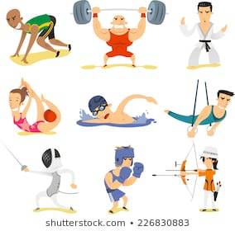
Ready, steady, sport. Be well 20 mins
Act a sport
Think of a sport
Act it out when you are called
Can the others guess what you are acting…

Slide 21
Wiggle words- Be well 20 mins
Spot the dangers – as you tell us you must WIGGLE your body as much as the danger.
Very dangerous WIGGLE ALL OVER,
Might be dangerous – wiggle your nose….

Slide 22
Know your coins Skills for my future 30 mins
Which is which? Match the coin with the number

Slide 23
Know your coins continued…. Put these in order

Slide 24
Know your coins continued… How much does the ice creams cost?

Slide 25
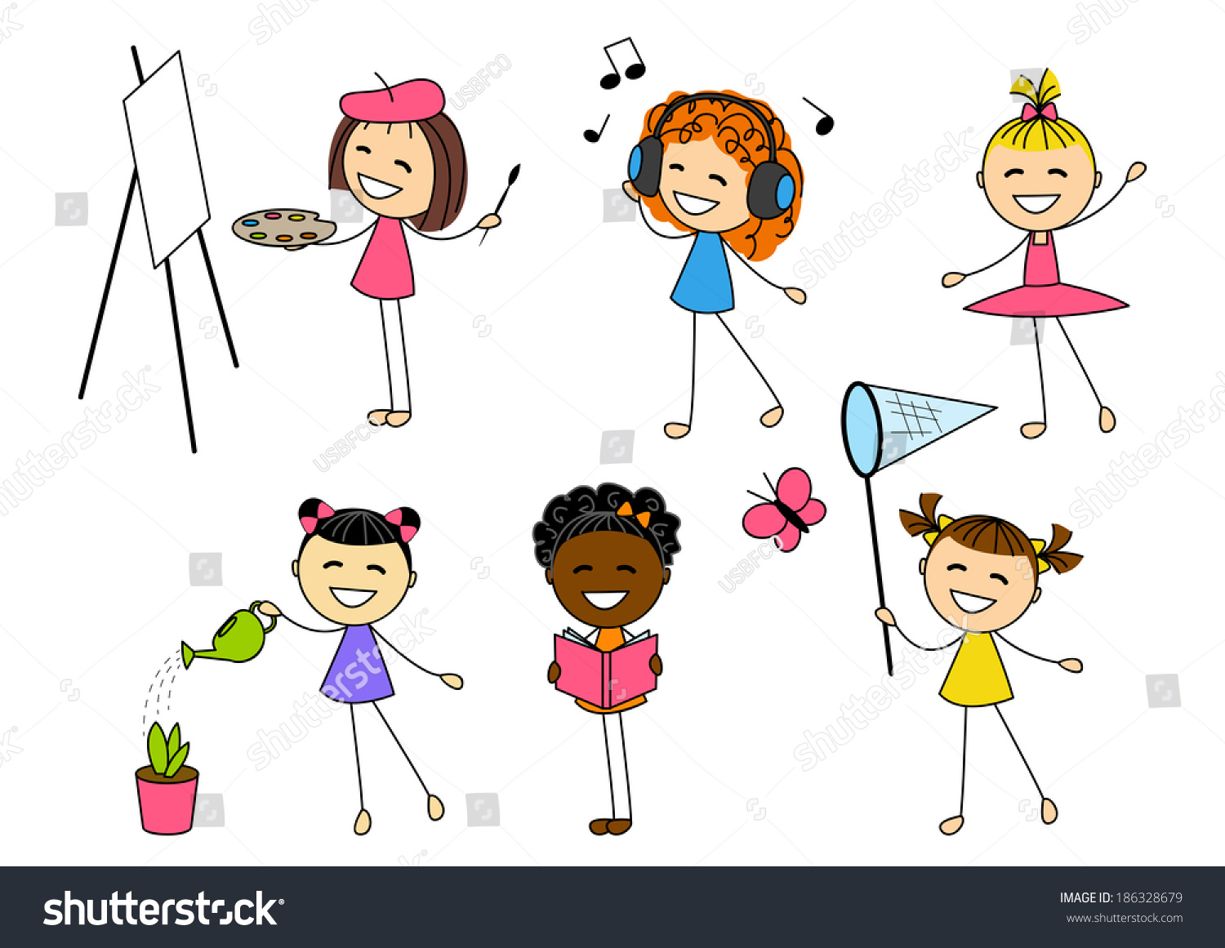
Hobby – tastic Express myself 30 mins
Mime your favourite hobby. Let’s see if we can guess what you are doing?

Slide 26
Mirror movements…..Be well 10 mins
Copy your leader – watch her
Arms
Faces
Arms
Feet
Arms
Body
Arms
Nose
Arms
2 parts might move now

Slide 27
Lets go Express myself 30 mins
Can you mime….
Lets review
Baking a cake
Skiing
Build a snowman
Play football
Dancing
Shopping
On a rollercoaster
Was it clear?
How could we improve it?
Lets try again

